Slide 1
Game Design
Jason Leigh
© 2003-2012 Electronic Visualization Laboratory, University of Illinois at Chicago

Slide 2
All Games Share 4 Traits
Goals – this is what your player is trying to reach and what you are trying to do to make it difficult for the player to reach.
Rules – this is what controls the way things work in your virtual world.
A Feedback System – stuff that happens that rewards you for succeeding or failing.
Voluntary Participation – people have to “like” / accept the rules, and rules have to be perceived as fair to both players and non-players.

Slide 3
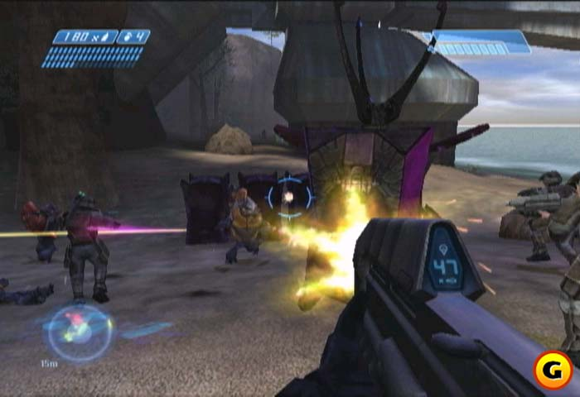
Goals
Outcome that players work to achieve.
Provides players with a sense of purpose.
Focuses the player’s attention & orients their participation throughout the game.
E.g. What are the goals of Halo?

Slide 4
Rules
Places limitations on how players can achieve the GOAL.
Rules are learned through interaction, not prestated.
By removing or limiting obvious ways to get to the goal (unnecessary obstacles), the rules push players to unleash creativity & strategic thinking.
E.g. In Halo, certain weapons have a certain range & quantity of ammo.

Slide 5
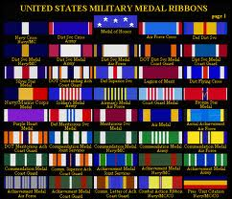
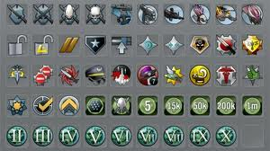
A Feedback System
Tells you how close you are to achieving the goal.
E.g. In Halo you advance through checkpoints, and through the story.

Slide 6
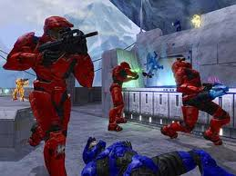
Voluntary Participation
Player knowingly and willingly accepts the goals, the rules & the feedback.
I.e. you are “game” for the game.
This knowingness establishes common ground for people to play together.
Freedom to enter or leave ensures that intentionally stressful & challenging work is experienced as safe & pleasurable activity.

Slide 7
Gameplay
The interplay between the GOALS, the RULES and the Feedback System can be described as the GAMEPLAY.
Lets go through the following genres of games and try to describe their game play.
What are the goals, rules and feedback systems for each of these games?

Slide 8
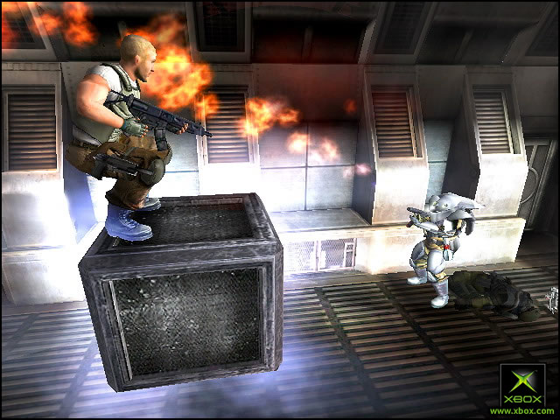
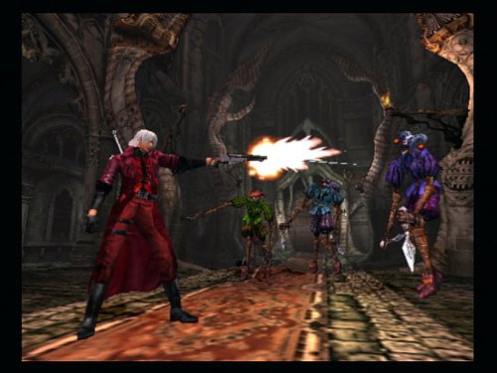
Action (1st and 3rd person shooters)
Halo – Bungie (2002)
Psi-Ops (2004)
Devil May Cry – Capcom (2001)
DOOM – id (1994)
Castle Wolfenstein - 1981

Slide 9
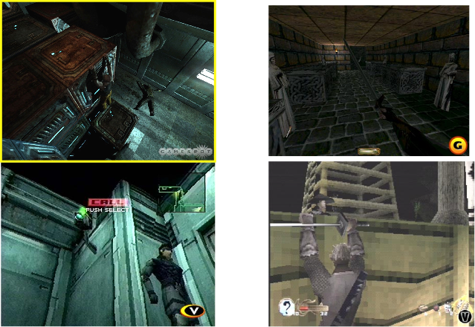
Stealth: A Sub-Genre of Adventure
Chronicles of Riddick (2004)
Thief: Dark Project (1999)
Tenchu (1998)
Metal Gear Solid (1998)
Notes:
If you are visible you will likely be overrun and killed- so stay hidden
Tenchu & MGS - earliest pioneers in the field
Tenchu has stealth meter to tell you how close enemy is. Sound becomes incredibly important.
Thief - has a darkness meter (hiddenness meter)
Riddick - has shiny eyes, and can hear the heart beat of his enemies. Multiple heart beats = multiple opponents. Minimal status information.

Slide 10
Fighters
Mortal Kombat Deadly Alliance –
Midway (2002)
Virtua Fighter – Sega (1993)
Karateka – Broderbund (1986)
Mortal Kombat – Midway (1992)

Slide 11
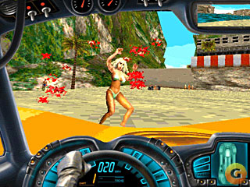
Driving
Grand Theft Auto 3 – Rockstar (2002)
Wipeout – Psygnosis (1995)
Carmageddon (1997)
Pole Position – Atari (1982)
Death Race – Exidy (1976)

Slide 12
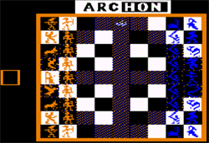
Real Time Strategy (RTS) Gameplay: Build armies and battle
BattleZone – Activision (1998)
Command and Conquer –
Westwood Studios (1995)
Archon – EOA (1983)
Eastern Front 1941 –
Chris Crawford, Atari (1981)

Slide 13
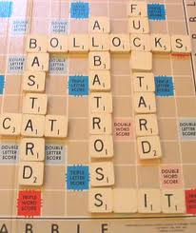
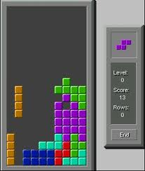
Definition of a Game
“Playing a game is the voluntary attempt to overcome unnecessary obstacles” - Bernard Suits (Philosopher at U Waterloo).
What are the unnecessary obstacles in: Golf, Scrabble, Tetris?
Why are so many people so willing to spend so much time on solving Unnecessary Obstacles?

Slide 14
Unnecessary Obstacles Work vs Play
We are taught that we PLAY games- which is the opposite of WORK.
Somehow Play is considered BAD.
Games & play have a bad connotation.
E.g. “Gaming the system”; “Don’t play games with me!”; “This isn’t a game!”; “He’s a player”.
Brian Sutton-Smith (Psychologist) says:
The opposite of play isn’t work. It’s depression!

Slide 15
What is Depression?
Clinical Definition:
Pessimistic sense of inadequacy & a despondent lack of activity.
What is the Reverse of this Definition?
Optimistic sense of our own capabilities & an invigorating rush of activity.
There is no clinical definition for this reverse state.
But it is so aptly describes the player’s experience when enjoying a game.

Slide 16
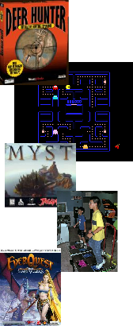
So Lets Look at What Work Means in Video Games
Closely mirrors the things humans have done to survive.
Collect
Hunt
Explore / Navigate
Socialize (to learn from others, to cooperate towards a goal)
To use tools
To reproduce
To be physical (e.g. dance, fight)
To solve problems or learn to adapt

Slide 17
But Work is not enough
It has to be HARD work.
Believe it or not: Hard Work makes us Happy.
WTF!? How can HARD WORK be FUN???

Slide 18
A Psychology Experiment To Find Out What Activities In A Day are Fun
Subjects interrupted at random intervals during a day with a text message & asked:
What are they doing
How do they feel
Called Experience Sampling (ESM).

Slide 19
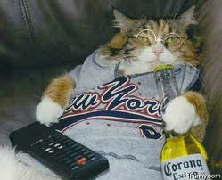
Common Finding:
Virtually every activity that is described as “relaxing” kind of fun (watching TV, window shopping) doesn’t make us feel better.
We consistently report feeling worse afterward than when we started “having fun”.
We feel less motivated, less confident, less engaged overall.
How can we be SO WRONG about what’s FUN?

Slide 20
We All Know What Makes Us Feel BAD
Psychologists believe that when we seek out relaxing fun, we're usually trying to reverse negative feelings associated with stress.
But by having EASY fun, we often wind up moving ourselves in the wrong direction.
We go from stress & anxiety to boredom & depression.

Slide 21
So What is HARD Fun?
It is when we experience positive stress or eustress (Greek eu means well-being - like euphoria).
Eustress is virtually identical to negative stress: we produce adrenaline, our reward circuitry is activated, our blood flow increases to attention control centers of the brain.
But what is different is our frame of mind.

Slide 22
Stress
When we are experiencing stress - we are afraid of failure or danger.
It makes us angry & combative, or want to escape & shutdown emotionally.
It can trigger avoidance behavior like eating, smoking & drugs.

Slide 23
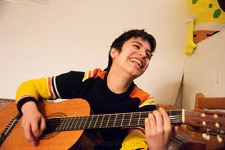
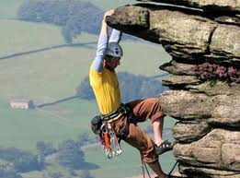
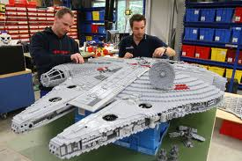
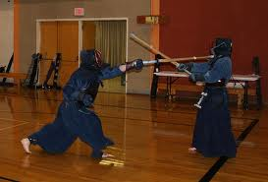
Eustress
In Eustress, we aren't experiencing fear or pessimism.
We generated the stress on purpose, so we are confident & optimistic that we can overcome it.
When we choose our hard work, we enjoy the stimulation & activation.
Highest levels of interest & positive mood reported by ESM is when subjects are playing games - sports, card games, board games, computer games.

Slide 24
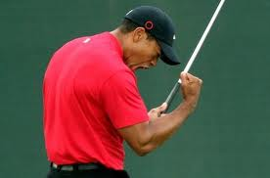
One More Emotional Benefit to Hard Fun
Fiero – Italian word for “Pride”
What we feel when we triumph over adversity.
We throw our arms over our heads & yell.
All humans do this.
It is deep within our evolutionary wiring.
Center for Interdisciplinary Brain Sciences Research at Stanford says: Fiero is the emotion that 1st created a desire to leave the cave & conquer the world. It's a craving for challenges that we can overcome, battles we can win, & dangers we can vanquish.
The more challenging the obstacle we overcome, the more intense the fiero.

Slide 25
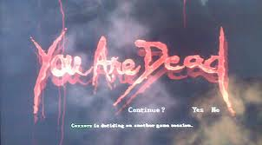
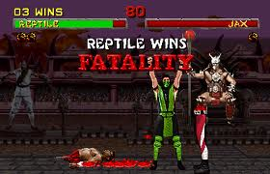
Fun & Failure
No one likes to Fail.
Gamers spend nearly all of their time failing.
4 out 5 times, gamers fail during gameplay.
Do Gamers enjoy failing?

Slide 26
A Study of Super Monkey Ball 2
M.I.N.D. lab in Finland showed that when we’re playing a well designed game, failure does not disappoint us.
It makes us happy in a very particular way:
Excited, interested, & most of all: optimistic.
Study involved 32 players with biometric sensors to measure heart rate, skin conductivity (stress), electrical facial muscle activation (detect smiles).
Goal: identify what triggered strongest emotional reactions (both positive & negative).

Slide 27
Hypothesis: Strongest positive emotion would come from earning high scores or completing difficult levels – i.e. Fiero moments.
Emotion from Fiero was indeed detected.
However they found something unexpected…

Slide 28
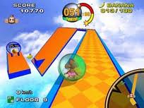
Players were most positive when they made a mistake & the monkey ball veered off side of the lane.
Excitement, Joy & Interest shot thru the roof on the biometric sensors.
When we fail in real life we are typically disappointed, NOT energized.
If we fail repeatedly we are MORE stressed, NOT less.
In Monkey Ball the opposite was happening.
Why?

Slide 29
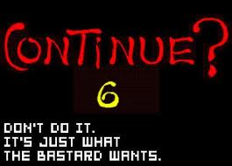
Monkey Ball gave players a vivid demonstration of a spectacular & entertaining failure.
Positive failure feedback reinforces our sense of control over the game’s outcome.
It makes us want to give it one more go because you believe there is a chance that you will eventually succeed.
Being really good at something is less fun than being NOT QUITE good enough– yet.
Games are only fun when you haven’t mastered them.
With games- Learning is the Drug.

Slide 30
How to Introduce Difficulty in a Game
Mihaly Csikszentmihalyi (psychologist at U of Chicago) - Flow, The Psychology of Optimal Experience.
Flow refers to a kind of optimal experience, which is simultaneously demanding and rewarding.
E.g. musicians lost in their music; programmers composing code; athletes who are “in the zone”; gamers playing for hours.

Slide 31
Dr. C suggests The Flow Channel - the path between 2 extremes of difficulty
Too Hard
(Becomes Frustrating to player)
Increasing
Difficulty
Game Difficulty Progression
Too Easy
(Becomes Boring to player)
Increasing Time (and Player Skill)

Slide 32
An even better way to introduce difficulty is as follows…
Too Hard
(Becomes Frustrating to player)
Increasing
Difficulty
Ideal Game Difficulty Progression
Provide variations in difficulty
Too Easy
(Becomes Boring to player)
Increasing Time (and Player Skill)

Slide 33
Take Home Message
Games make us Happy because it is Hard Work that we Choose for Ourselves.
Techniques for developing good gameplay can be applied to making your real lives more motivating. Work becomes Fun.
Think about the same traits that are so successful in games (Goals, Rules, Feedback, Participation) and create them in what you do in life.
You become “Happiness Engineers”, not just for games, but for LIFE too!

Slide 34
CS 426
Designing the Game
© 2003 - 2011 Jason Leigh Electronic Visualization Lab, University of Illinois at Chicago

Slide 35
What’s the Algorithm?
Quickly sketch/write out your ideas (see next slide).
Rapidly build a “toy” prototype to play with the ideas.
E.g.: http://balldroppings.com/js/
Scrap the prototype if it doesn’t work out.
Add to the prototype if it does work out.
Keep iterating…

Slide 36
Primary Things to Think About
What is the goal?
What are the obstacles stopping you from reaching the goal?
What’s the visual representation?
How do you interact with the world?
What’s the reward for success?
What’s the reward for failure?
What’s the surprise (e.g. boss or humor)

Slide 37
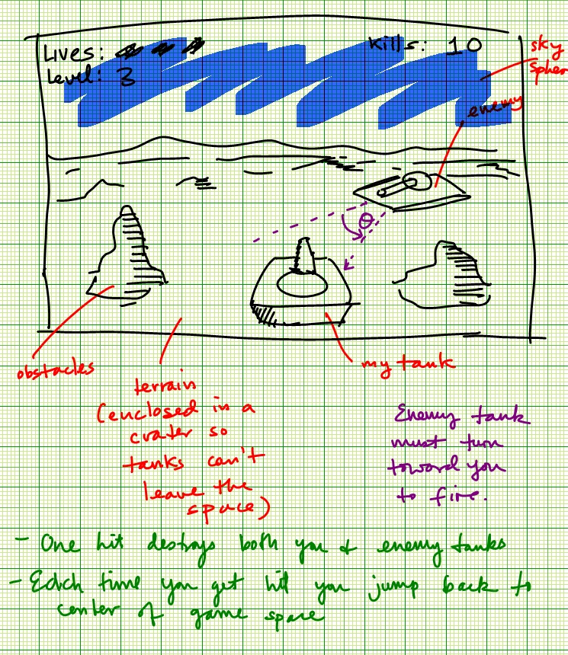
1. Brainstorm the Gameplay (Using Storyboards)
Brainstorm the GAMEPLAY!
DO NOT start by brainstorming the opening cutscene of the game.
Draw them by HAND. NOT BY COMPUTER.
Do them FAST.
Let the IDEAS flow.
DO NOT JUDGE the Ideas

Slide 38
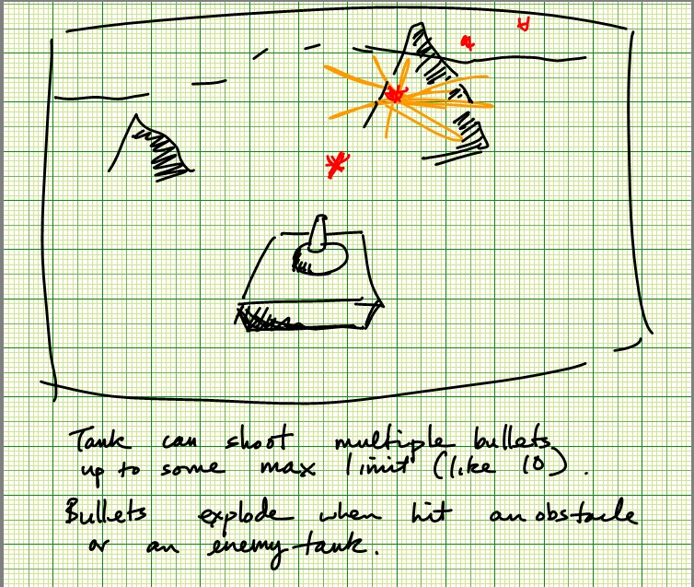

Slide 40
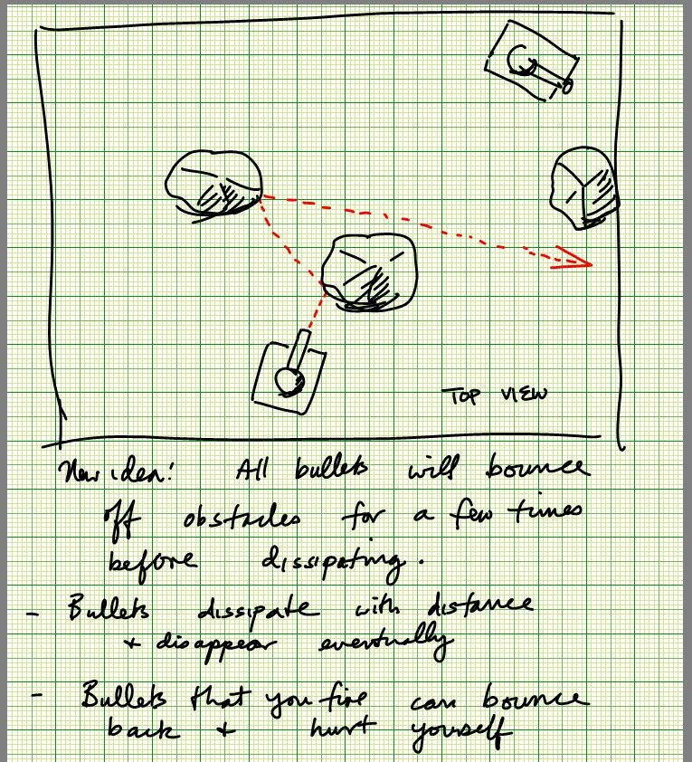

Slide 41
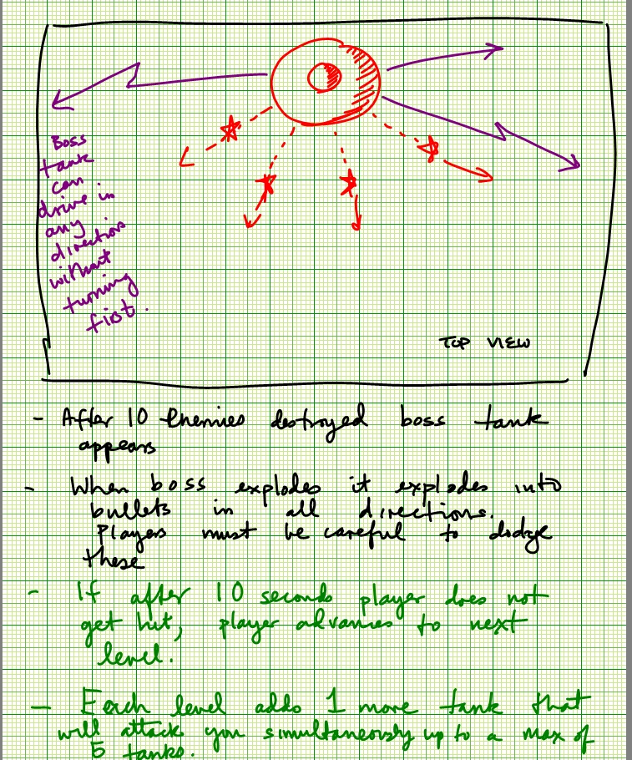

Slide 42
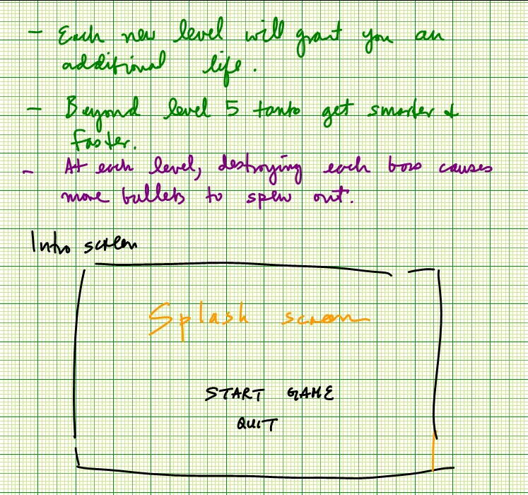

Slide 43
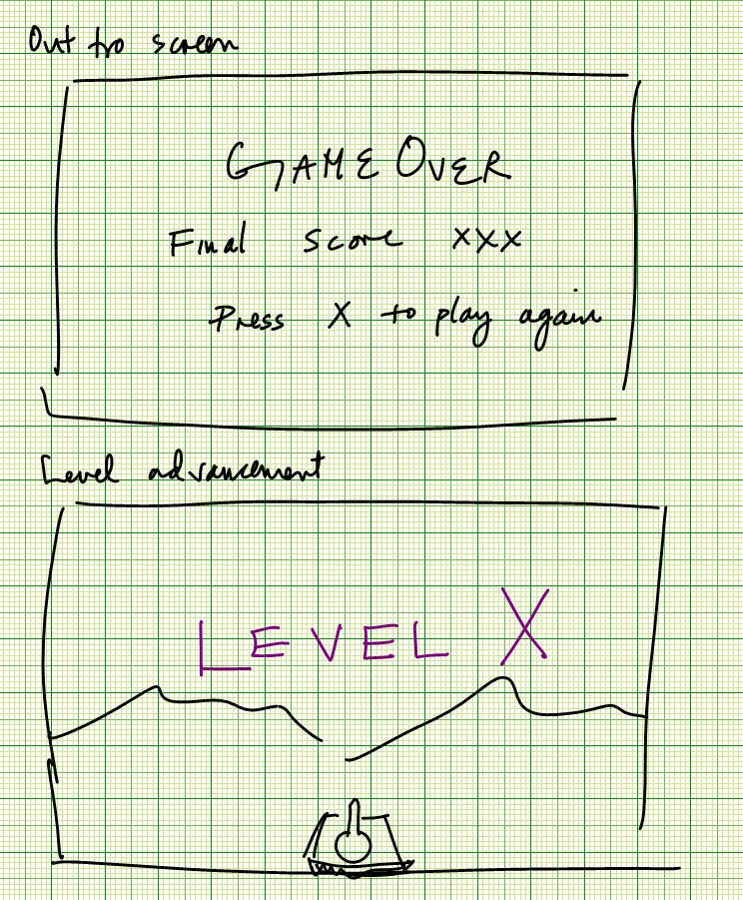

Slide 44
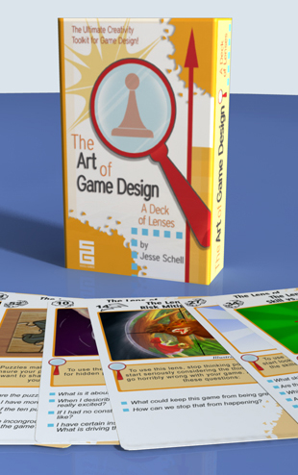
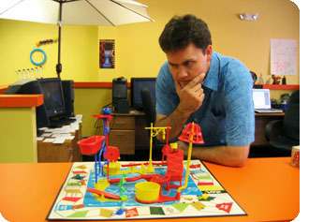
2. Critically Analyze Your Designs: Art of Game Design Cards
Developed by Jesse Schell.
Teaches game design at Carnegie Mellon’s Entertainment Technology Center.
Stack of 100 Cards that ask critical questions about game design.

Slide 45
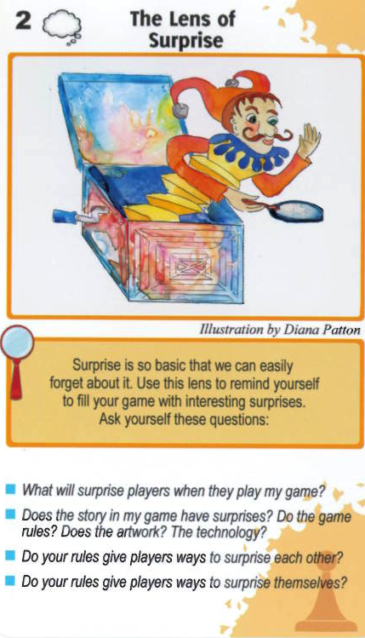

Slide 47
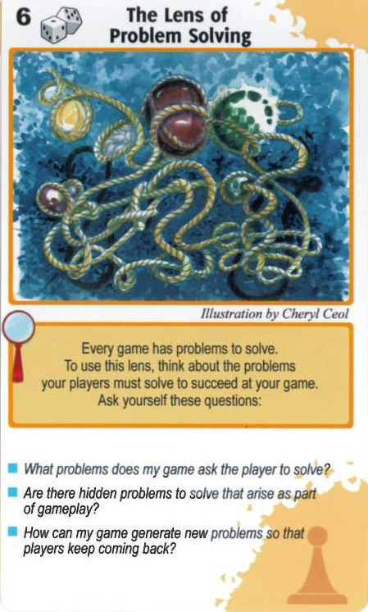

Slide 48
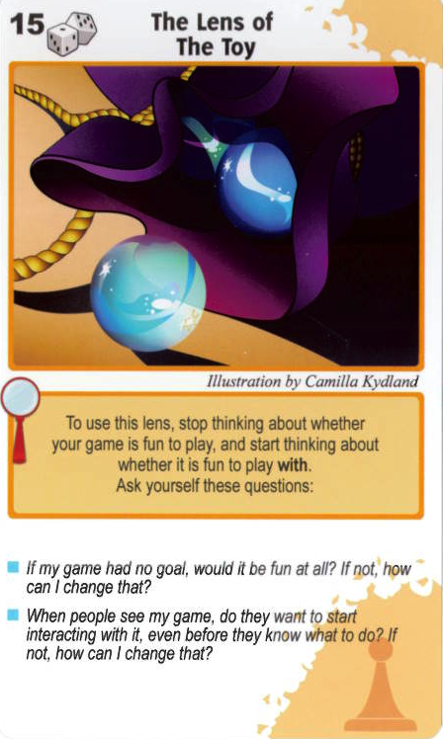

Slide 49
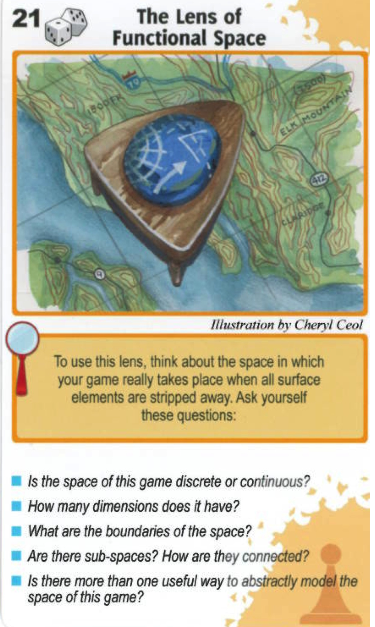

Slide 50
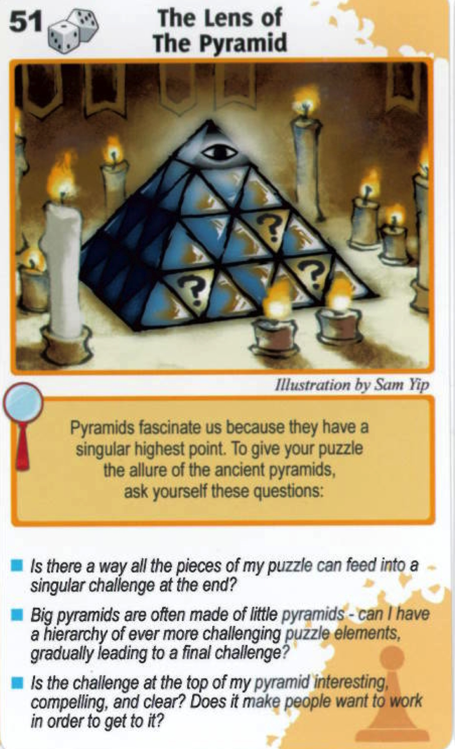

Slide 51
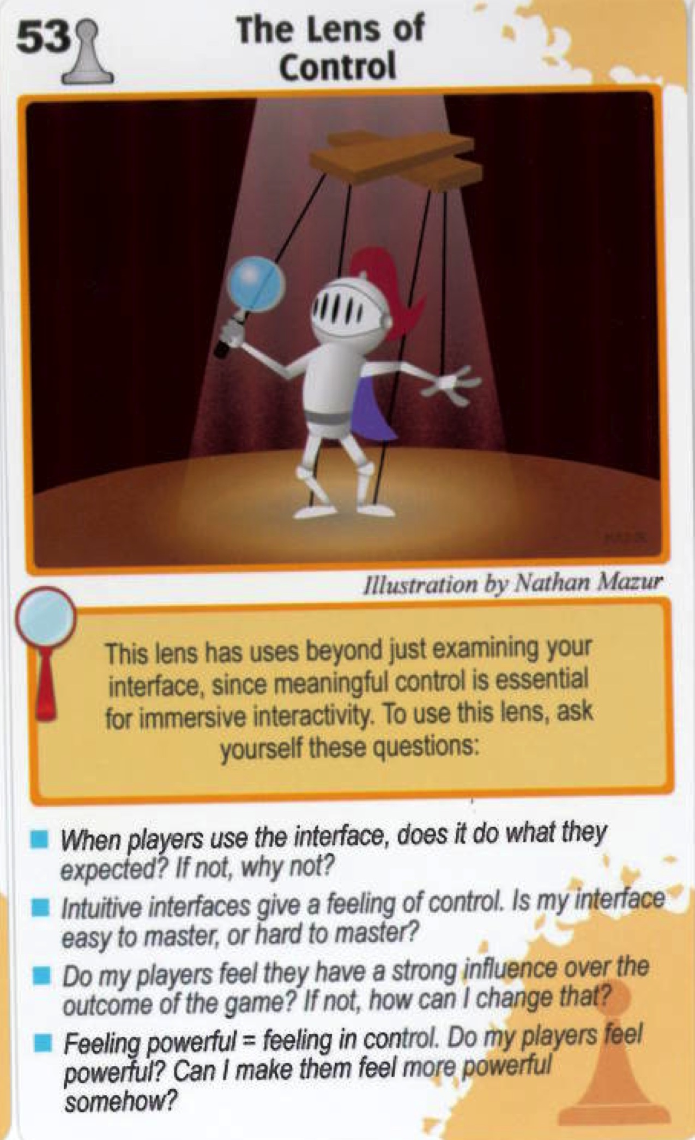
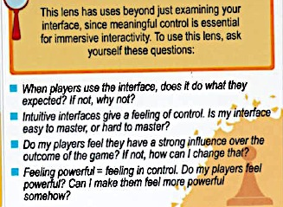

Slide 52
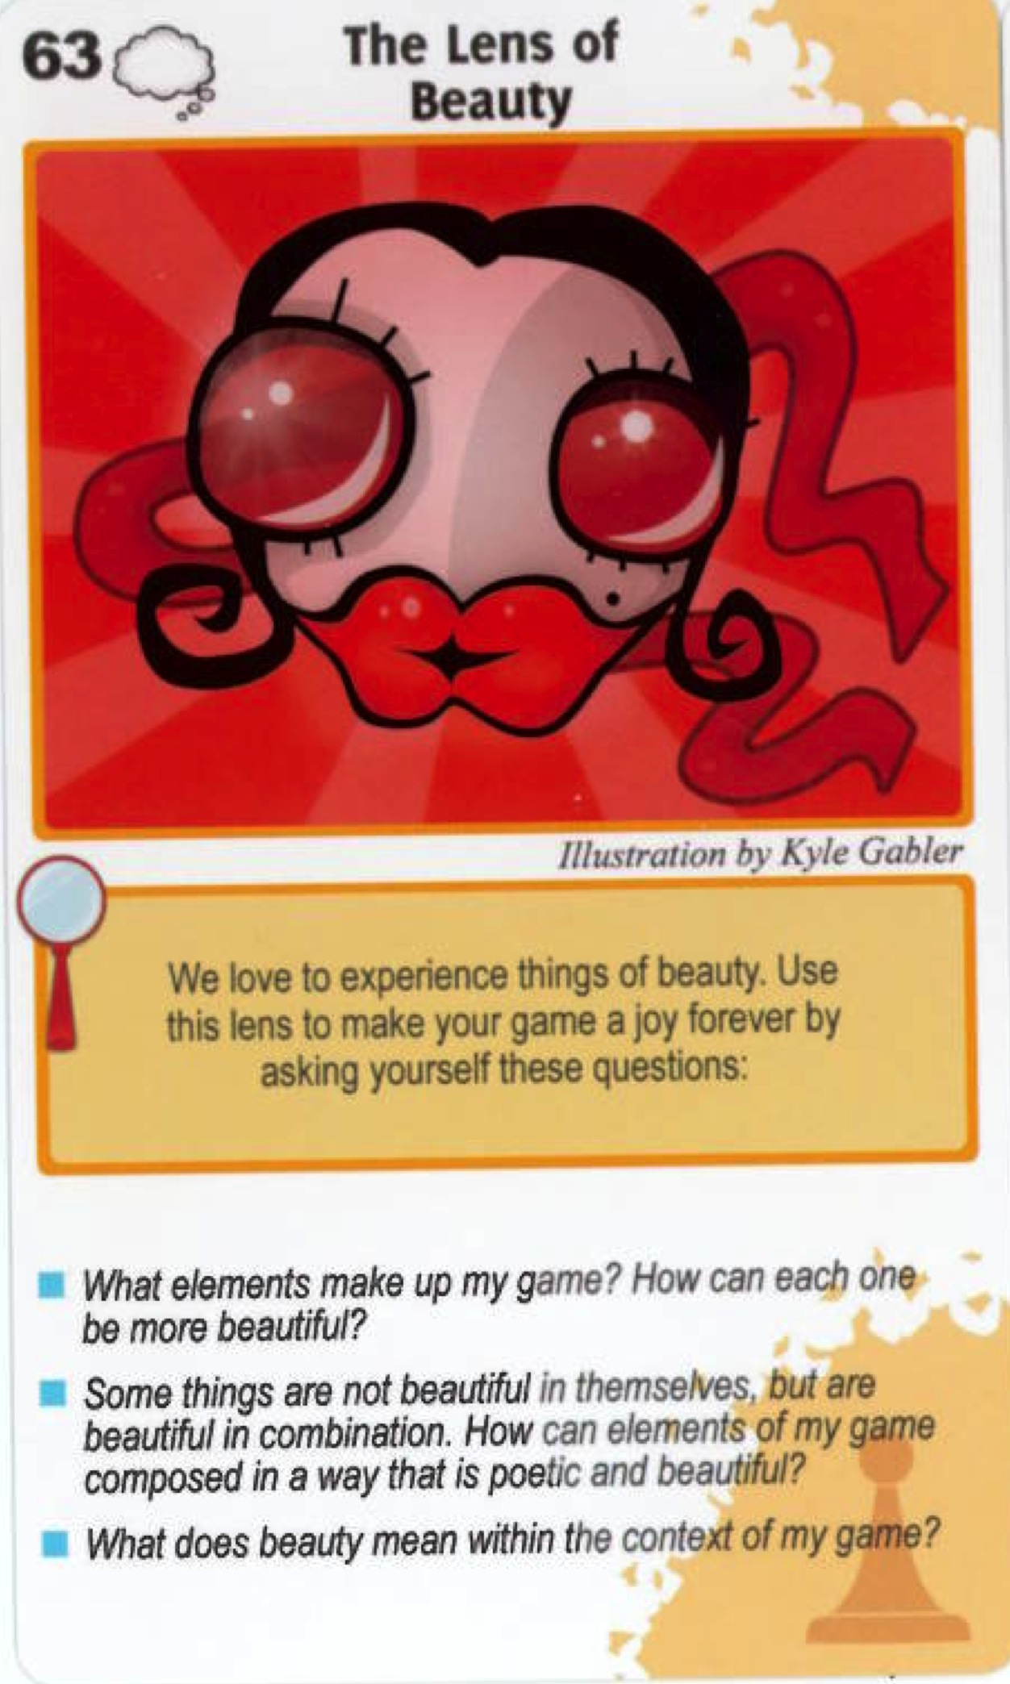

Slide 53
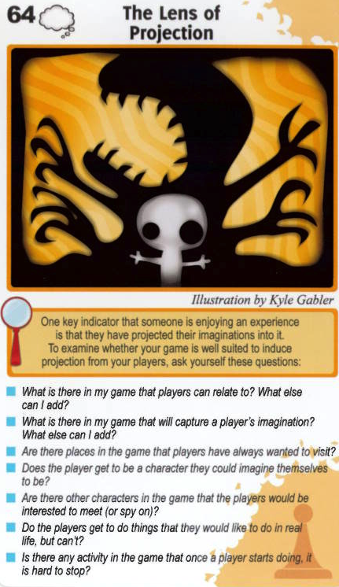

Slide 54
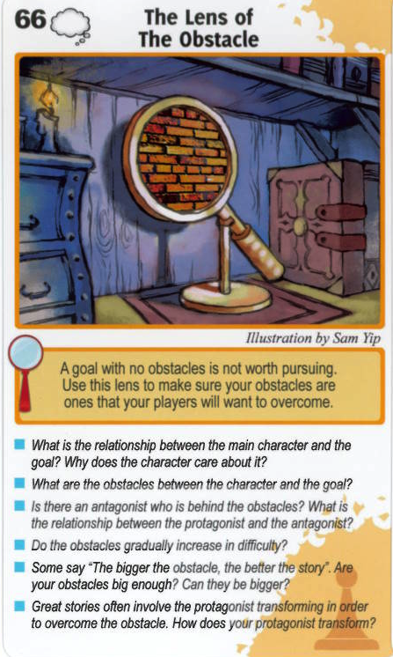

Slide 55
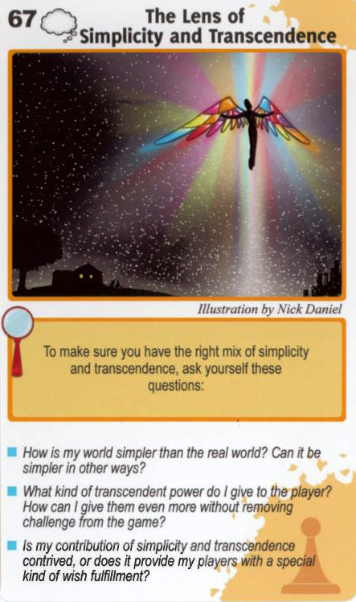

Slide 56
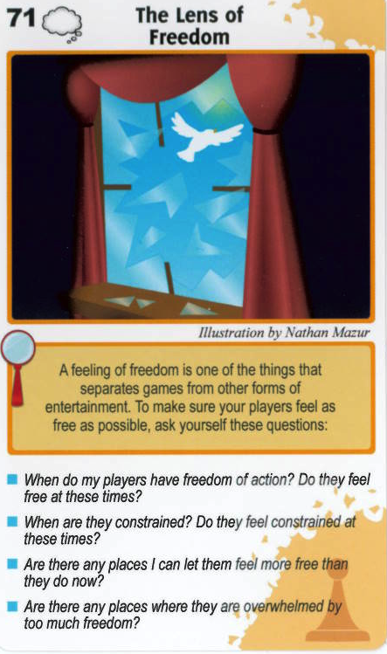

Slide 57
Project Management

Slide 58
Project Management 101
You depend on each other for the overall success of the team.
You are here to all work 110% because frankly that should be your philosophy in everything you do.
There is too much mediocrity in the world why contribute to it?
“I am taking too many classes” is NOT a valid excuse. You are all adults / seniors / juniors / graduate students.
In life the only time positive things happen to you is if you do something well. Even then there are ways to do things better- so start with the best you can and always try to do better.

Slide 59
Project Management 101
When discussing issues:
Give everyone a chance to explain their decisions.
Provide criticism on the work, NOT the person.
Provide constructive but mindful ideas of how to improve something. E.g. “have you thought about trying X? The reason is, if you try X….”
Never take criticism personally.
No Whining- just get it done- ie are you an AmeriCAN or an AmeriCANT?

Slide 60
Everyone is busy - Always respect everyone’s time. So:
Be on time at meetings. If you are late for a meeting you inconvenience others. It shows lack of respect for other people’s time. My schedule does not revolve around yours.
If you have to be late due to something you cannot control, call someone at the meeting.
Set an agenda for the meeting well before the meeting.
After a meeting write down a list of resolutions / tasks / directives for each person. If someone comes away from a meeting with nothing to do- something is very wrong.

Slide 61
Project Management 101
Set goals, create a timeline, assign responsibilities.
See: OPPM (One Page Project Management)
I am going to evaluate individual team members using this chart and a end-of-semester evaluation form.

Slide 62
Project Management 101
Note any special dates like family travel / religious holidays etc on the timeline so your colleagues know well in advance that you will be tied up.
Exchange cell phone, email, IM addresses.
Use the HD video conference equipment in ICL.
Create backups of your work on multiple computers / media. Backup includes your web site.
Integrate parts of your game as often as possible- preferably weekly. DO NOT WAIT TILL THE END TO INTEGRATE.
Keeping a constantly working version provides visible progress & therefore encouragement.
Test this game on your friends for feedback. Write down the feedback and save it for your web site.

Slide 63
Responsibility of the Project Manager
Schedule weekly meetings.
Collect and distribute all contact information.
Make sure there is an agenda at every meeting.
Make sure the agenda is followed.
Make sure backup versions are being made.
Make sure the team rehearses their demos.
Check on status of deliverables at each meeting.
Listen to your team members, NOT dictate- you haven’t earned that right.
The only thing the manager can dictate is what I recommend- only because I have more experience.
Make sure there are action items after each meeting.
Make sure the overall game is developed on time- that the game development team is not stuck in a technical problem they can’t solve.
Manager needs to know when to cut their losses and come up with a backup plan.
Make sure the web page is well designed and documented- provides a professional image of the company.

Slide 64
Responsibility of the Team Members
Attend all meetings.
Be active in all meetings.
Provide deliverables on time.
Be communicative / responsive to email & make your team mates constantly aware of your development status.
Show new progress at EVERY team meeting- with a short mini-demo. Again: if you have nothing to show it usually means you haven’t done anything.
Voice technical and schedule concerns to manager- remember the Space Shuttle disaster?
Subtle way to tell someone they are not pulling their own weight:
“Dude, you’re clearly overloaded, why don’t I work on that instead.”

Slide 65
Cultural Differences: Artists vs Computer Scientists
Artists don’t know and care (rightfully so) why something is not possible, or how difficult something is to do.
CS people are sometimes over constrained by what they think they can do.
CS people tend to like certain things solely on its technical merits rather than whether something fits in the overall vision of things. I.e. don’t see the forest for the trees.
Artists understand the concept of showtime- i.e. getting something finished to a point that is presentable.
CS people tend to tinker forever – “just-one-more-feature-itis”.
Artists are experienced in taking and giving feedback through a process of critiquing.
CS people take it personally when you don’t like their work.
There are fine artists and graphic artists. Good art doesn’t necessarily translate to good communication. Graphic artists are generally better at balancing the two.
Artists tend to be more “obsessed” with creating their own identity in the art world.
Artists tend to think of CS people as their computer support.
CS people tend to think Artists are “dumb”.
CS needs to build a test harness or basic game environment for artists to test out their artwork in parallel while you are developing new code.

Slide 66
(Agile) Game Development Cycle
Identify a small handful of top priority features/capabilities
Design and implement the features
Test the individual features
Integrate features
Test integrated system so far
Repeat for next set of features
For the class the recommended cycle time is 2 weeks MAX.
But you should have WEEKLY working BUILDS.
If a feature is late chances are you will never catch-up, so cut your losses and determine what you can cut from the game.
POLISHING CAN TAKE A LOT MORE EFFORT THAN CREATION.

Slide 67
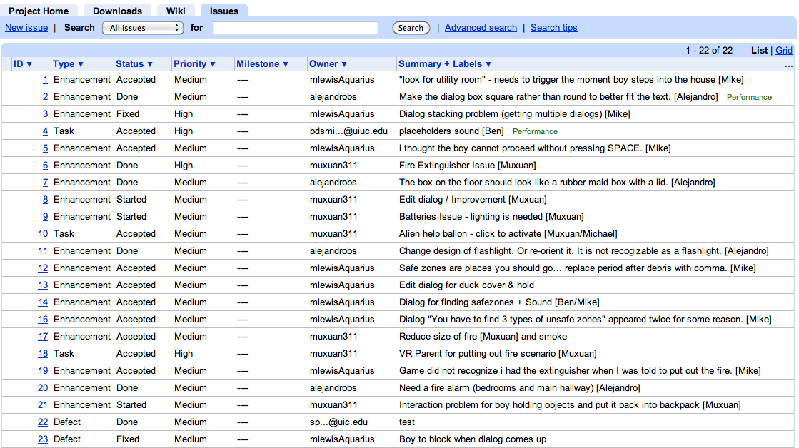
Development Tip: Issue Tracking

Slide 68
Slide Morgue

Slide 69
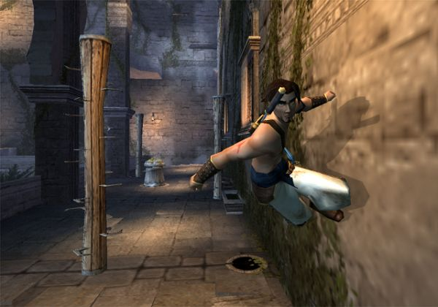
Adventure
Prince of Persia – Ubisoft (2003)
Tomb Raider – Eidos (1996)
Mark of Kri – San Diego Studios (2002)
Infocom Games - 1981
Adventureland – Scott Adams (1978)

Slide 70
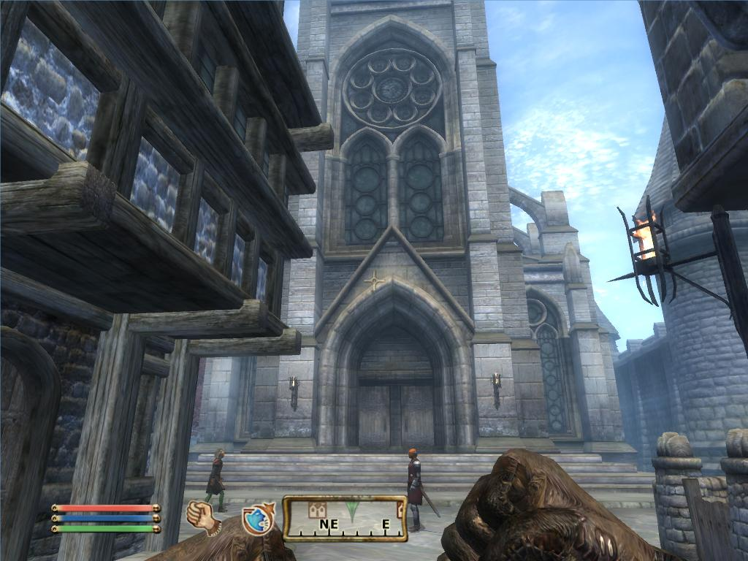
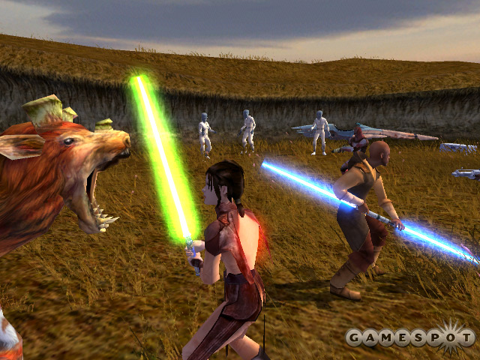
RPG Gameplay: Similar to adventure, less emphasis on action, more emphasis on statistical dice rolling to determine outcome
Elderscrolls Oblivion –
2K Games (2006)
Gauntlet Dark Legacy – Midway (2002)
Knights of the Old Republic –
BioWare (2003)
Wizardry – Sir-Tech (1979)
Gauntlet - Midway (1985)

Slide 71
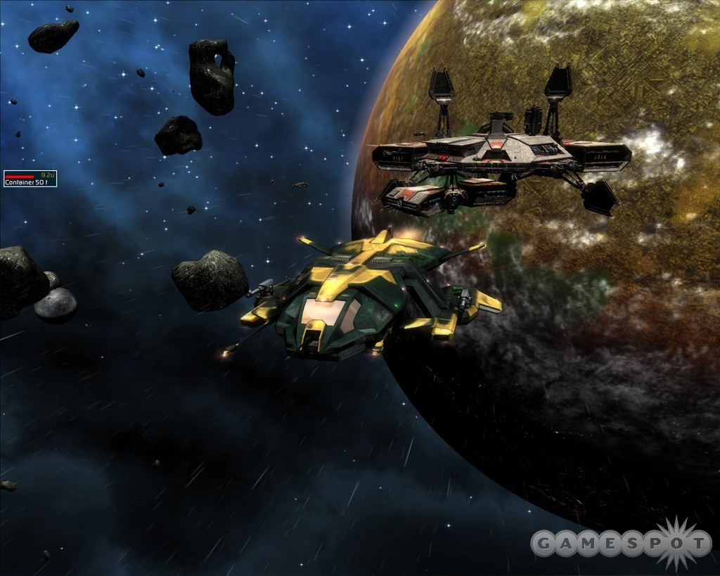
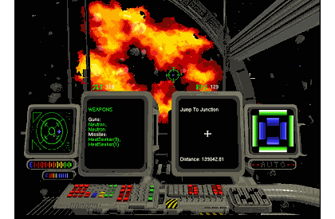
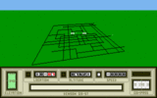
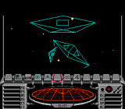
Space Simulations Gameplay: Fly through space and shoot things Become a privateer
Darkstar One – Ascaron Ent. (2006)
Privateer – Origin (1993)
Mercenary –
Novagen (1985)
Rogue Squadron – LucasArts (2001)
Star Raiders –
Doug Neubauer, Atari (1979) (8K)
Elite - Acornsoft (1984)
Wing Commander –
Chris Roberts, Origin (1990)

Slide 72
Empire Building
Master of Orion – Simtex (1994)
Civilization – Sid Meier, Microprose (1991)
MULE – Ozark Softscape (1983)
Notes:
"4X" games: 4X, meaning explore, expand, exploit, and exterminate
Key issues are ai, interface and dealing with micromanagement

Slide 73
Sports
Madden NFL 07 –
Electronic Arts (2006)
FIFA 07 –
Electronic Arts (2006)
Olympic Decathlon –
Microsoft (1981)

