Slide 1
CS 426
Considering the User in
Video Games
© 2003-2009 Jason Leigh Electronic Visualization Lab, University of Illinois at Chicago

Slide 2
Prior studies in human perception and performance can help guide game design.

Slide 3
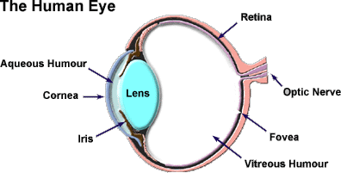
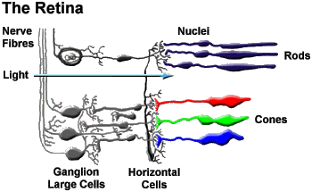
Human Visual System
Fovea
8 million cells
High resolution primarily for daylight viewing and color perception
Retina
120 million cells
Low resolution for detecting movement.
Sensitivity to color and motion
Putting a lot of detail in the interface at the perimeter of a first person shooter’s display screen might be a waste.
Notice that in a driving game, it is very difficult to admire the scenary and drive competitively at the same time. Sometimes it’s more fun to watch the game than play it.

Slide 4
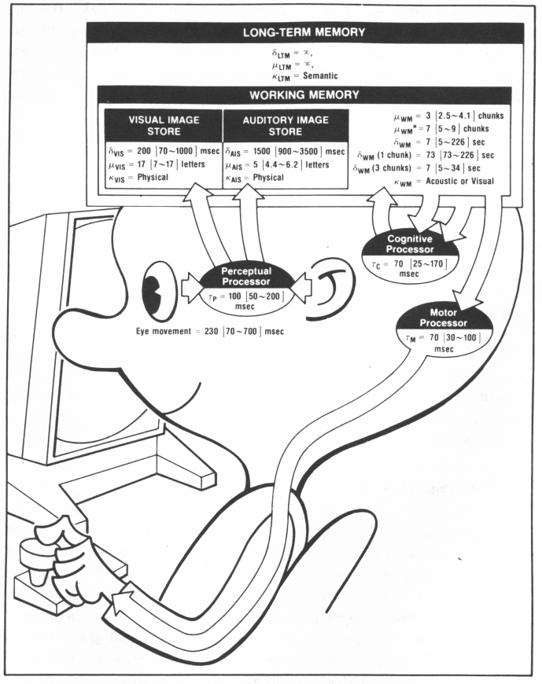
Model Human
Processor
The Psychology of Human-Computer Interaction by Stuart Card
Many experiments dating back to the 1960s to predict how quickly humans can detect and respond to a stimulus.
E.g. User sees a sequence of random characters on the screen and is asked to press a button every time he sees an A.

Slide 5
Results- and ramification for video games
Perceptual processor
Time it takes for visual system to detect a change: 100 [50~200] ms
Cognitive processor
Time it takes for you to identify what it is: 70 [25~170] ms
Motor processor
Time it takes to tell your finger to press the button: 70 [30 ~ 100] ms
In a button masher game you cannot expect the average player to be able to push buttons in rapid succession faster than 70ms.
Total: 240 [105~470] ms
In a fighting game, the average player will not be able to see a punch and block it faster than 200ms. (ie if you graphics update is at 30 frames/second [ie 33ms] and if there are fewer than 6 frames of animation in a punch, then the user won’t have enough time to see and block it)
If they are experts they may be able to react as fast as 105ms- but no faster.

Slide 6
Eye Movement
Time it takes to move your eye from one part of the screen to another: 230 [70-700] ms
Try to keep frequently used info in the center of the screen rather than in the periphery.
Effective working memory is 7 +/- 2 items. In this some long term memory is involved.
In practice average person can keep about 3-4 items in his/her head at a time.
For RPGs, if you have many quests for a player, you should keep an automated journal that the player can refer back to later- especially if the player might only play the game once a week.
Interestingly enough: No game ever uses techniques from TV soap operas: “… in our last episode”.

Slide 7
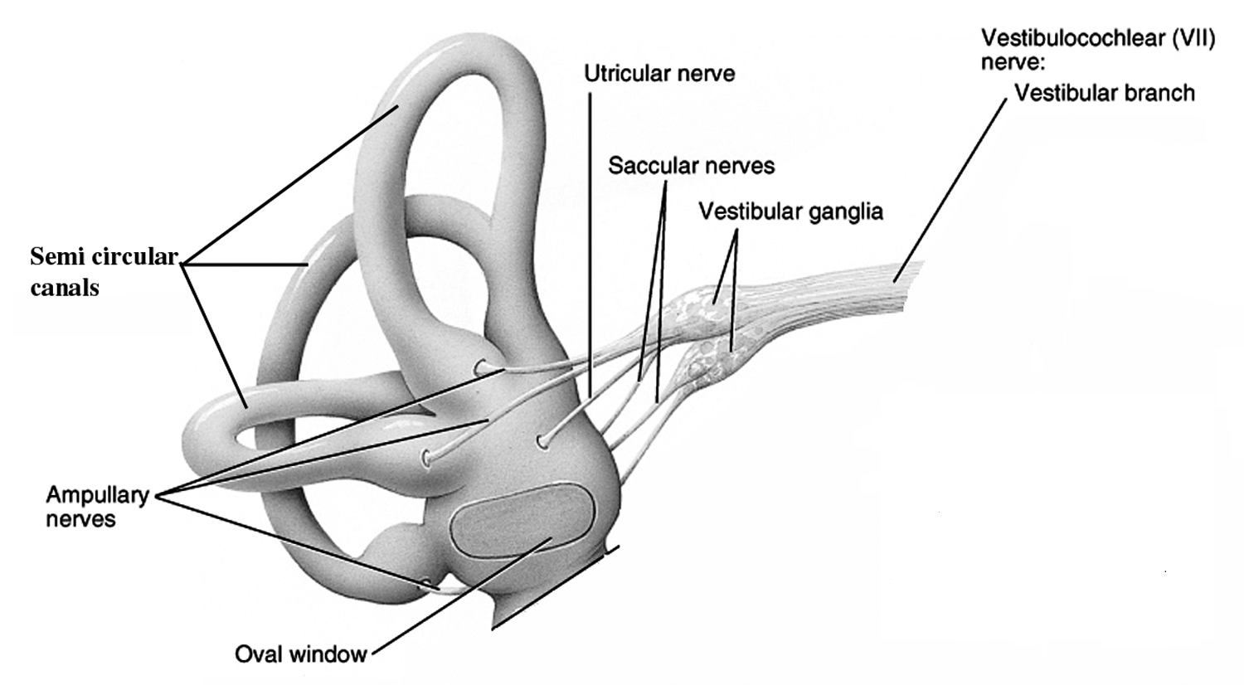
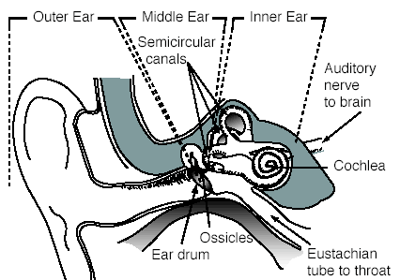
Motion Sickness
Symptom
Nausea, discomfort, dizziness, drowsiness
Cause
Conflict between visual system and vestibular system.
The organ of the inner ear containing three semicircular ducts at right angles to one another.
Responsible for maintaining the body’s orientation in space, balance, and posture; regulates locomotion and other movements and keeps objects in visual focus as the body moves.

Slide 8
Remedies for Video Game Motion Sickness
Close your eyes.
Or take a walk around the block if you can do it without falling over.
Break the illusion of motion by NOT covering your entire field of view with the game screen. (ie sit back so that you can see the edges of your monitor- your mother was right!)
Do not play in a dark room- for the same reason as above.
Avoid scenes where you are rolling about the Z axis.
Higher frame rates can actually INCREASE the sense of motion.
But the jarring effect from lower frame rates can cause eye strain.

Slide 9
Seizures
Japan – 6:50pm Dec 16, 1997: 685 people (310 boys, 375 girls) , most of them children, simultaneously felt ill from watching Pokemon show. 150 were hospitalized.
Cause was a red/blue flashing at 12Hz from one of the video game worlds in the show.
Formerly it was known that:
Rapid light/dark changes or alternating high-contrast patterns cause nerve cells in the brain to fire electrical impulses more rapidly than usual.
In people with photosensitive epilepsy this lead to muscular convulsions or loss of consciousness.
Pokemon incident “discovered” a new type of seizure:
Chromatic sensitive seizure- Red / Blue flashing
1993 – Advertisement in UK had fast moving computer graphics images. Caused a # of complaints from viewers & 3 cases of seizures.
1994 – Independent Television Commission, which regulates commercial TV in UK, limited the rate of flash to three per second.
Flashing images, especially those with red, should not flicker faster than 3Hz.
If the image does not have red, it still should not flicker faster than 5Hz.
Flashing images should be displayed for a total duration of less than two seconds.
Stripes, whorls and concentric circles should not take up a large part of a TV screen.

Slide 10
All Video Games Now Include a Standard Warning…
WARNING: READ BEFORE PLAYING
A very small percentage of individuals may experience epileptic seizures when exposed to certain light patterns or flashing lights. Exposure to certain patterns or backgrounds on a computer screen, or while playing video games, may induce an epileptic seizure in these individuals. Certain conditions may induce previously undetected epileptic symptoms even in persons who have no history of prior seizures or epilepsy.
If you, or anyone in your family, have an epileptic condition, consult your physician prior to playing. If you experience any of the following symptoms while playing a video or computer game -- dizziness, altered vision, eye or muscle twitches, loss of awareness, disorientation, any involuntary movement, or convulsions -- IMMEDIATELY discontinue use and consult your physician before resuming play.

Slide 11
Theories / prior studies can only tell you so much about game design because they were designed to answer a specific question that might not be the same question you are asking, like: "how do I make my game more fun for more gamers?" In this case FEEDBACK is crucial

Slide 12
4 Important Criteria for Feedback
The feedback should accurately represent the opinions of the target gamers. Your own impressions or your group’s impressions do not qualify.
The feedback should arrive in time for the designer to use it. If the feedback is perfect, but arrives too late the feedback isn't that helpful.
The feedback should be sufficiently granular for the designer to take action on it. Not general theories.
The feedback should be relatively easy to get. Need to estimate how much it costs you to get the feedback and weigh it against how valuable the feedback will be. Spending $100K to determine if the sports car in the game should be red or blue is not worth $100K.

Slide 13
 | Accurate | Rapid | Sufficiently Granular | Easy to Get
Dev Team |  | Y | Y | Y
Consultants- Journalists / Gurus | ~ | ~ | Y | N $
Newsgroups/Fans | Y | N demo needed | N | Y
Acquaintances- Friends/Neighbors | Y | N demo needed | Y | Y
Focus Groups | Y | N | Y | N $$$

Slide 14
2 Common Sources of Feedback: Professionals and Gamers
Professionals:
Development group members: satisfies criteria's 2,3,4.
External consultants (game journalists, gurus): Satisfies criteria 3. Maybe 1 and 2.
Problem is that game developers and journalists know the area too well. Similar to how film critics judge the film as terrible but the public loves it.
Non Professionals:
Newsgroups, fan mail: satisfies criteria 1 but requires a prototype to already be developed. This makes it difficult to satisfy criteria 2. Satisfies criteria 4 since fans are always very vocal. But sometimes difficult to satisfy criteria 3.
Acquaintance testing: friends & neighbors. Satisfies 1, 3 and 4. But not 2.
Focus groups: typically done by publishers. Costly and typically comes late in the development phase- too late.

Slide 15
Approach taken by Microsoft Game Studios
Usability research (small sample observational studies)
Playtest research (large, structured questionnaire studies that focus on the first hour of game play.)
Reviews from user-testing specialists.

Slide 16
Usability research (small sample observational studies)
Originates in the field of applied psychological and Human Computer Interaction research.
Goal: discover problems that the dev team was unaware of, and to understand the thoughts and beliefs of the participant and how they affect their interaction with the game.
Over the course of 2-3 days, 6-9 participants come to Microsoft for individual 2-hour sessions.
Each participant spends some unstructured time exploring the game prior to attempting a set of very specific tasks.
Common measures include: comments, behaviors, task times and error rates.

Slide 17
Playtest research (large, structured questionnaire studies that focus on the first hour of game play.)
Originates from psychology in the fields of judgment and decision-making.
Goal: Gauge participants' attitudes, preferences, and some kinds of behavior, like difficulty levels.
Sample sizes are relatively large (25-35 people) in order to be able to compute reliable percentages.
Each person gets just over 60 minutes to play the game and answer questions individually on a highly structured questionnaire.
Participants rate the quality of the game and provide open-ended feedback on a wide variety of general and genre-specific questions.

Slide 18
Reviews from user-testing specialists
Specialists have a lot of experience watching users play games and listening to their complaints and praises.
Specialists can identify early on, mistakes that development teams typically make and correct them.

Slide 19
Focus Groups
If used at all, are used for early feedback on ideas.
Not very good for evaluations.
Group nature of focus groups makes it difficult to get useful individual opinions about a game.

Slide 20
Composition of Microsoft User-Testing Group
15 fulltime user-testing specialists
3-5 contract specialists
3 fulltime support staff.
Almost all user-testing specialists at least 2 years of graduate training in experimental psychology, or equivalent experience in applied psychology and are gamers.
In 2001- tested approximately 6500 participants in 235 different tests, on about 70 different games. 23 were non-Microsoft products.
From 1997 to Jan 2002- group has produced 658 reports on 114 products (53 Microsoft, and 61 non-Microsoft products) representing the opinions of more than 15,000 hours of consumer reactions to games prior to their release.

Slide 21
Hardware Interfaces

Slide 22
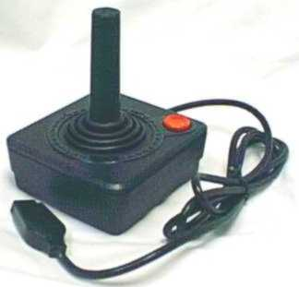
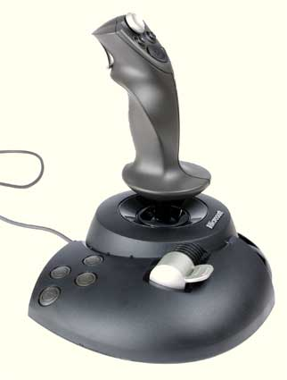
Joysticks
Joysticks were the predominant gaming interface for almost a decade.
But they proved difficult for games requiring fast response.
So the stick shrank and the result is the gamepad.
But joysticks-proper continued to evolve.
Today’s joysticks are mainly used for flight simulation or robot driving games.
Force feedback sticks have their own CPU and cooling fan.

Slide 23
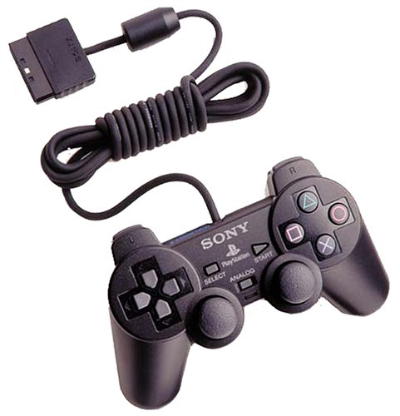
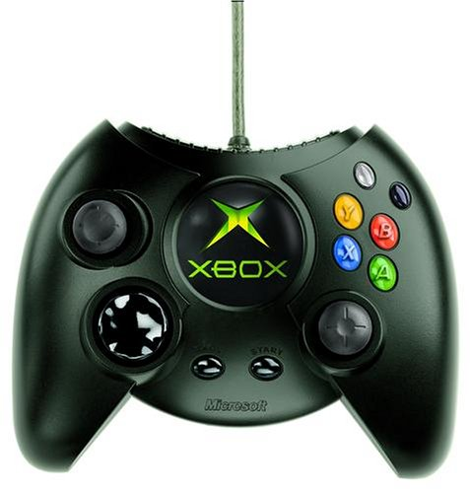
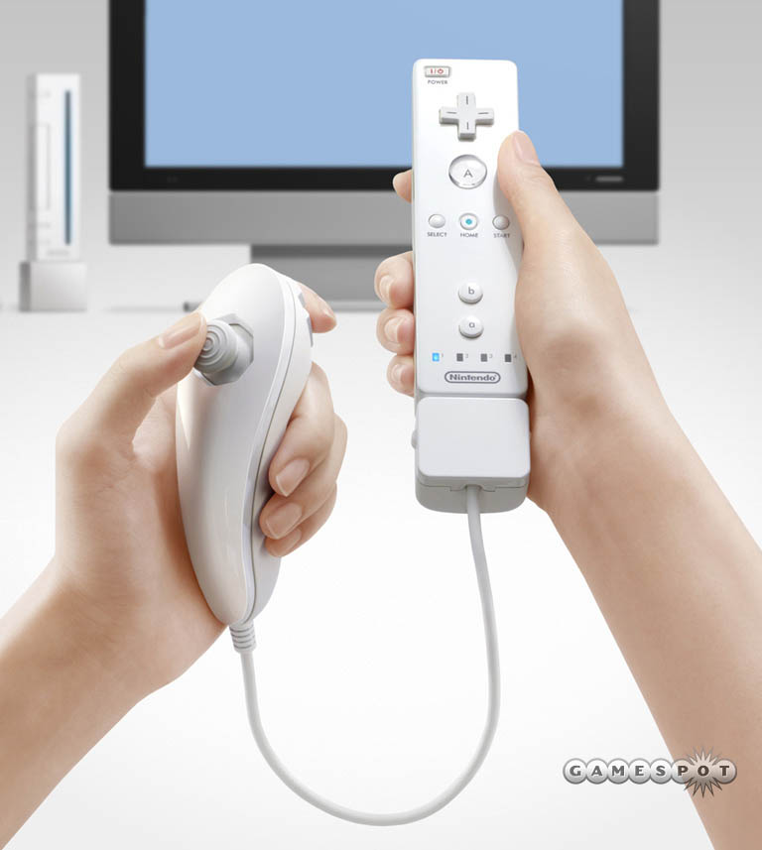
Gamepads
Multipurpose device.
Combination of digital and analog joysticks.
Initially intended for platform games.
Small joystick allows for quicker movements than arm-based flight joysticks.
Button placement is designed to maximize the # that a player can press at the same time.
Expectation is that today’s gamepads come with vibration capability.
Lacks fine control for first-person shooters except maybe for Nintendo Wii controller.

Slide 24
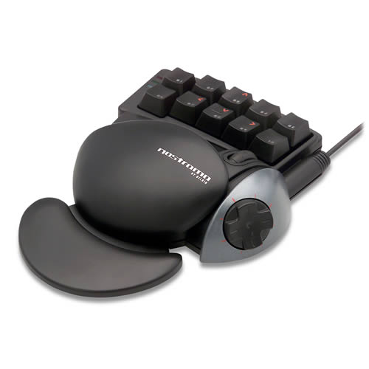
Belkin Nostromo Speedpad N50
Crouch,
Jump,
Additional powers
Quick save
Cycle weapons
Interesting innovation.
FPS do not play well on gamepads.
Too many keys and too little precision.
Gamers typically use the keyboard and a mouse on their computer.
Speedpad is used in conjunction with mouse.
Isolates important game keys alleviating the need to take eyes off the screen.
D-Pad for movement

Slide 25
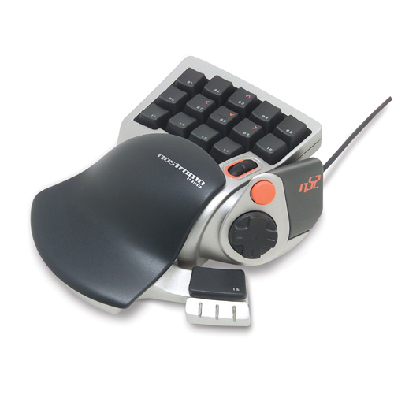
Belkin Nostromo Speedpad N52
Next generation responds to user feedback:
Able to press more than 3 keys at a time.
More keys so that D-Pad could be used for item selection rather than as a movement control.
Most FPS gamers are more familiar with WASD mapping for movement rather than D-Pad.

Slide 26
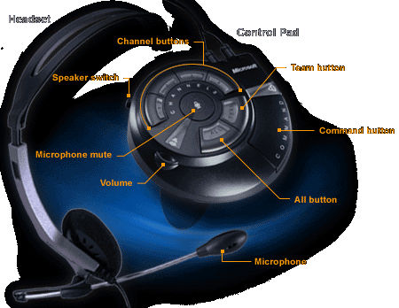
Microsoft Gamevoice
Userful for hands-busy, eyes-busy environments.
Good for commands that take a lot of effort to operate- e.g. commander on a submarine.
Humans are forgiving of each other when mistaking speech; humans are also more flexible when interpreting speech & we use context to improve interpretation rate. So we tend to scrutinize computer systems more when they fail.
Cognitive load is high when using speech. Difficult to talk and think at the same time.
30 years to attempt to put speech into fighter jet cockpits have failed.

Slide 27
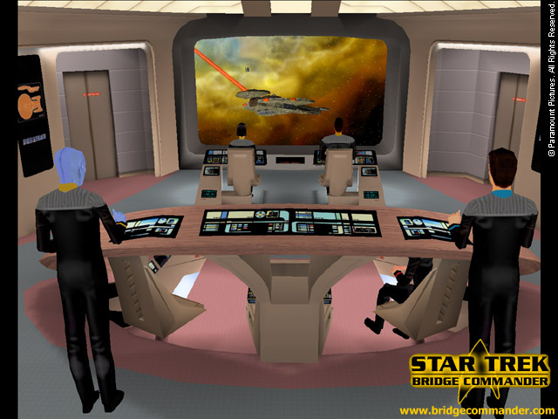
Speech recognition system is programmable to press a key on the keyboard.
Unfortunately few games have enough key bindings to make this possible.
Also used as an internet voice chat during multiplayer gaming. This is probably the better use for voice.
Voice command either via free speaking or push-to-talk to prevent accidental triggering.
Delay introduced in waiting for the system to confirm detected command, so Not good for single commands especially in fast paced games- like 1st person shooters.
Faster to press a key than to say it.
Speech recognition is most effective when:
it takes longer or is more tedious to conduct the actions manually (like key press / mouse clicking) than it is to say something.
Used sparingly - voice fatigue.
Users are not computer savvy.
Hands and eyes are busy.
e.g. Red Alert = target enemy, increase front shields, charge weapons, increase speed to half impulse.

Slide 28
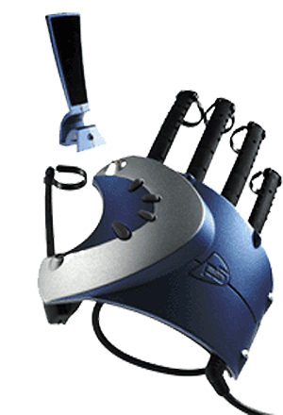
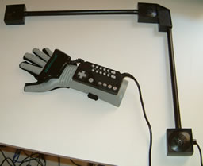
Essential Reality P5 Glove or Nintendo Power Glove
P5 used Infra-red emitters on glove.
Nintendo used ultrasound.
Camera performs 3D position and orientation tracking
Resistive bend sensors
Arm fatigue (guerilla arm) prevents use for more than 5 minutes.
Researchers in the VR community have known this for over a decade.
Calibration is needed for each individual.

Slide 29
Camera Tracked Interfaces Eye Toy
Camera tracking of a player’s head and hands.
Works quite well.
Antigrav is an excellent example of a well designed game for the interface.
Problem though is fatigue…

Slide 30
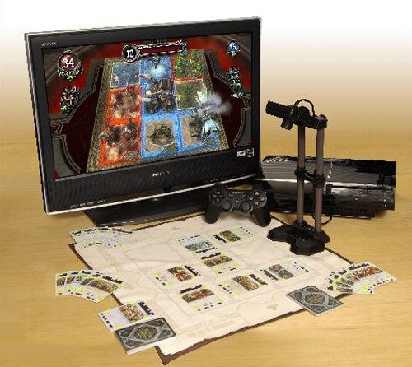
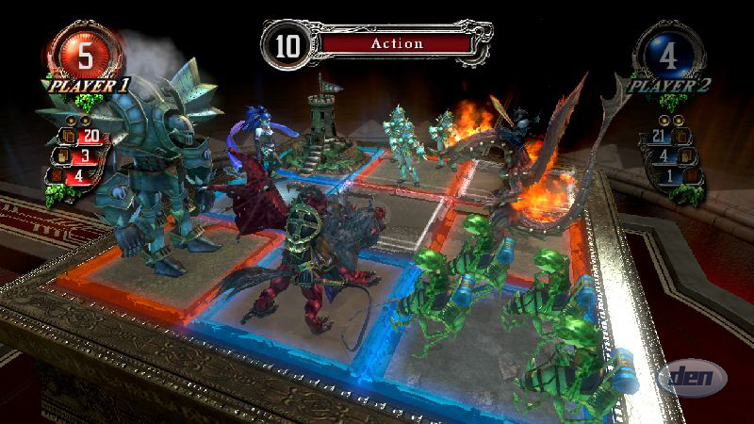
Camera Tracked Interfaces Eye of Judgement
Increased processing power enables new uses of camera technologies
Special markers on cards enables computer vision algorithms to detect the position & orientation of a card.

Slide 31
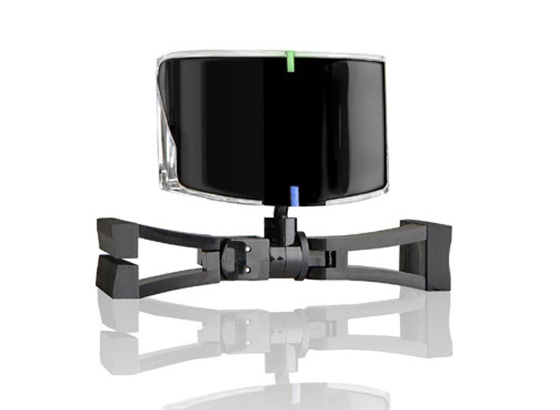
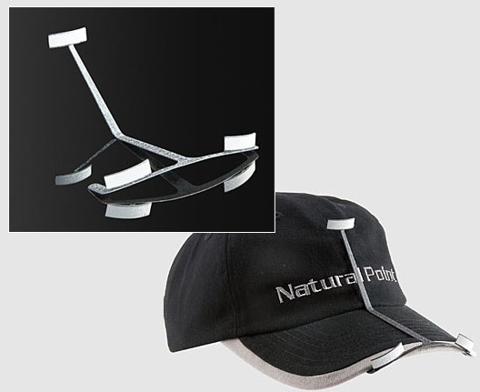
Camera Tracked Interfaces TrackIR
Camera tracks retro-reflective markers to determine position and orientation.
Reflectors are lit by Infrared light source in camera system.

Slide 32
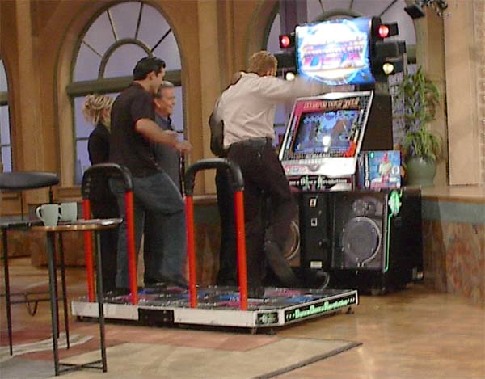
Getting People Back Into the Arcades Dance Dance Revolution (DDR) Pad
It’s interfaces like this that draw people back into the arcades.
Dance Dance Revolution (DDR)
Snowboarding
http://www.youtube.com/watch?v=wSQd4n-Ts7k
http://www.youtube.com/watch?v=6JzcqALklRs
http://www.youtube.com/watch?v=06m-S8U_XUA

Slide 33
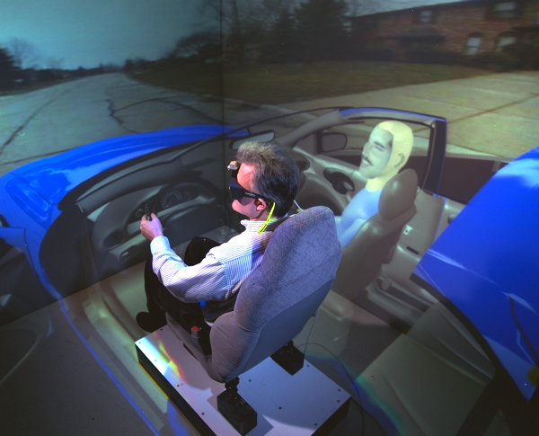
Stereoscopic Computer Graphics
Technology has been in existence for more than 10 years. (Stereographics Corporation designed them mainly for Chemistry)
Field sequential stereoscopic at 60Hz (30Hz per eye)
Each eye goes opaque by polarizing each lens.
Synchronization is either via a cable or via infra red emitter and receiver.
4 graphics buffers:
Rear left, rear right, front left, front right
Draw to rear, swap both.
30Hz is too slow- flickering is very noticeable.
The ones used in the CAVE are 120Hz (60Hz per eye).
Players only able to tolerate flicker for brief periods of time.
Stereo enabled by graphics cards are stereo driver enhancements for DirectX.
Only works on CRTs- not LCD screens becoz LCDs are polarized screens.

Slide 34
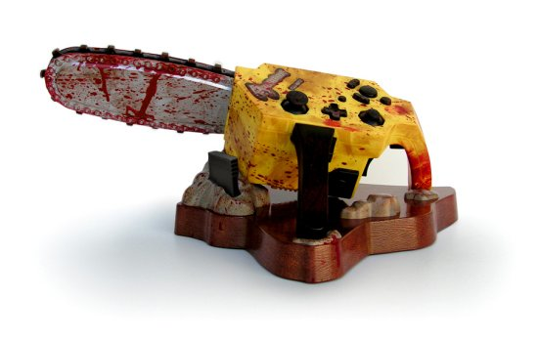
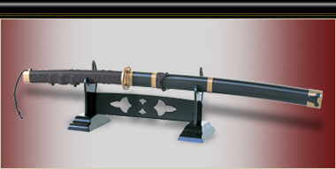
Other goofy controllers
Onimusha 3 Katana Controller ($190)
Resident Evil 4 Chainsaw Controller ($60)
Pull cord to start game ☺

Slide 35
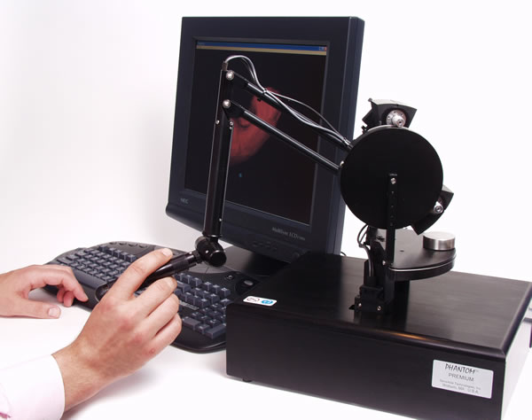
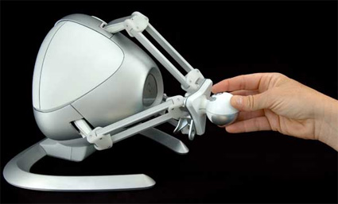
Haptic Interaction
SensAble Phantom $20,000
Novint Falcon $200
PC maintains both a visual representation of the scene and a version of the scene containing information about haptic surfaces.
When user pushes the device against a supposed surface the internal motors in the device operate to oppose your push.

Slide 36
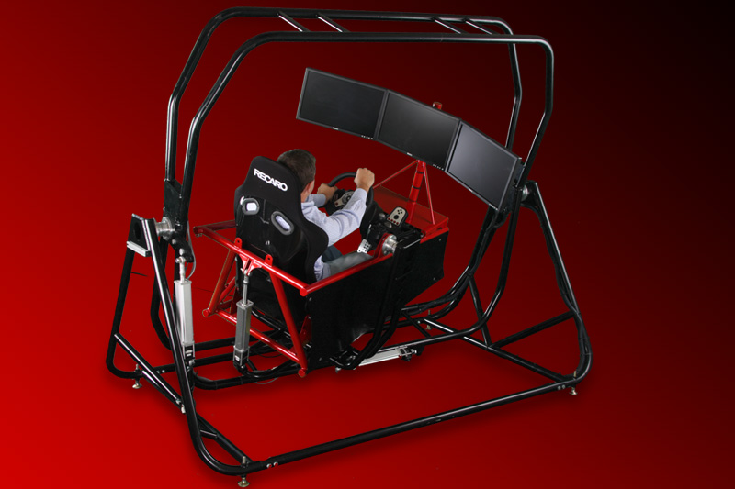
More Haptics
Logitech G25
Simcraft APEX
3rd Space
Gaming Vest
Buttkicker

Slide 37
Public Service Message
http://www.youtube.com/watch?v=fbiHwGBsRr0

Slide 38
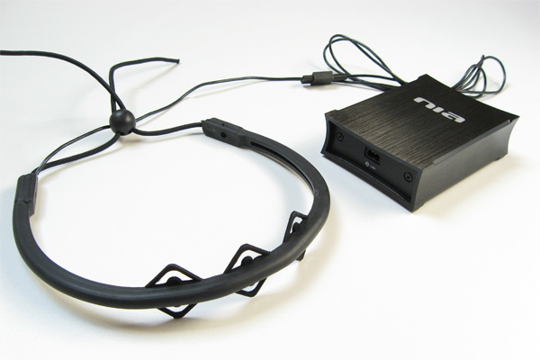
Neural Interfaces
Emotiv
OCZ NIA
Based on EEG (Electroecephalography) technology to measure electrical brain activity.
Considerable training is needed for effective use.
System must learn what signals you emit.
This technology is now affordable because of low cost of powerful digital signal processors.

Slide 39
Criteria for a successful hardware interface
Must allow a player to use the interface for long periods of time without fatigue or discomfort.
Gamers can play on a computer or a console for hour(s).
Devices must provide a noticeable advantage over existing controls- e.g. a mouse with lots of buttons is great for first-person shooters.
Benefit must outweigh the cost.
Device must be robust- withstand aggressive use.

Slide 40
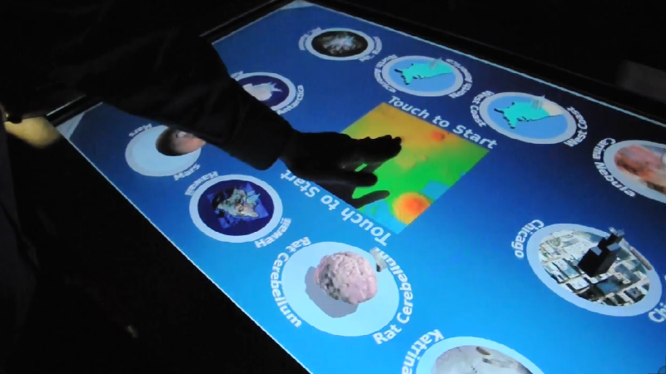
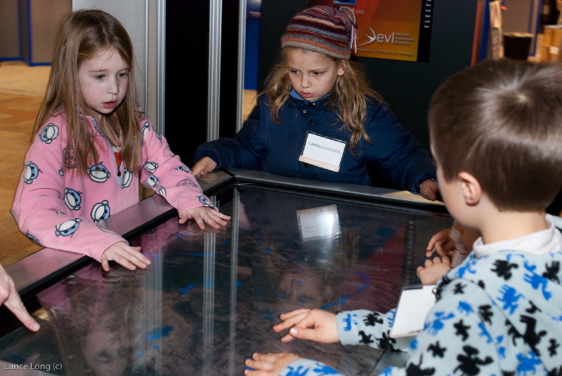
Some Thoughts About Multi-Touch Table Interaction
There is no “up” or “top” necessarily so there may not be a “correct” orientation for text.
More than 1 player can provide input at a time.
Gesture tracking challenging if more than 1 user wants to gesture at the same time. E.g. zooming vs raining.
Can’t guarantee that touch ID will perfectly track a touch point, especialy when movement is fast.
Test often on the TacTile because how you think your interaction scheme will work, may not work as intended.
Try to have a working build of game each week so your UIC team mate can test on TacTile each week and report back.
Could potentially track pressure too based on blob size.
Can also use external objects- anything that emits infra-red. E.g. flash light. Make your own custom chess piece.

Slide 41
References
http://www.bassdove.demon.co.uk/pokemon.htm
http://www.microsoft.com/playtest/publications.htm
www.cs.umd.edu/~ben/p63-shneidermanSept2000CACMf.pdf

Slide 42
Flicker Fusion Frequency
Rate above which the human eye can no longer recognize discontinuous changes in brightness as a flicker.
31.25 Hz for most humans. Some can see up to about 50Hz.
Video game monitors should ensure that they are set at refresh rates higher than this rate. Typically 60Hz is used in monitors.
Highest quality monitors today refresh at 120Hz (at most).
Most consumer monitors refresh at about 60 to 80Hz.
Some games claim several hundred frames per second. This is impressive but ultimately not perceivable by the human.
Plus, if graphics are not synchronized with the vertical blank of the screen- image will appear to tear even at high frame rates.
So for optimal graphics presentation you synch the frame rate with the refresh rate so that image buffer swaps occur ONLY during vertical blank cycle.

