Slide 1
CS 426
Game AI
© 2003-2010 Jason Leigh
Electronic Visualization Lab, University of Illinois at Chicago

Slide 2
The computer always has perfect knowledge of the entire virtual world. When you press a button the computer knows instantaneously that you have pressed it. That means in a fighting game, it can always deflect every blow you dish out and dodge every bullet!
The noble goal is to require that the AI system follow the same rules and constraints as the human so that it plays fairly. E.g. in a strategy game the human can only see parts of a map that they have explored.
In practice this is still very difficult and many AI systems still seem “dumb” in certain circumstances. E.g. Jedi Academy game, NPCs often fall to their deaths.
To get around this the AI system “cheats” a little but not so much that it is obvious to the player.
Game AI is largely an unsolved problem.
NPCs still follow a limited set of rules based on FSMs and rule-based systems. They cannot do more than what is expected of them. Especially evident in RPGs which have a limited set of responses to user input. You cannot have a long and open ended conversation with the computer.

Slide 3
Mainstream AI techniques that have been applied to Games
Finite State Machines – states, inputs and transitions to represent a system. Used in practically all games.
Production Systems – essentially a set of if-then-else rules that match a set of input & generate a new set of “input” that may cause other rules to fire- hence the system is capable of performing inferencing. Useful in adventure games when a combination of inputs and states can infer something about a situation.
Search – permuting all possible states of a game board to attempt to predict outcome. Used in chess and pathfinding.

Slide 4
E.g. Search : Tic-Tac-Toe Search Tree (with symmetric moves removed)
Possible
player’s moves
Possible
computer’s moves
Alternate between permuting all the players moves & all the computers moves. Estimate a “fitness” at each level so the computer can decide the “best” move to make up to a specified “lookahead”.

Slide 5
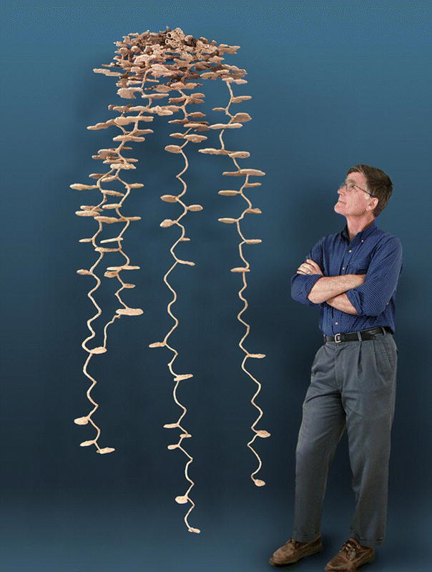
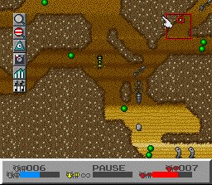
Mainstream AI techniques that have been applied to Games
Planning Systems – used to determine the best set of tasks needed to go from a start state to an end state. Useful for organizing a collection of troops for a unified goal.
Mult-agent Systems – studies how emergent behavior can arise from the interaction of a number of cooperating agents with limited knowledge.
Agents are essentially individual FSMs with sensors.
NPCs are essentially modeled as Agents.
Artificial Life – multi-agent systems that attempt to use living systems to simulate AI agents. Used in games like SimCity, SimAnt, Spore.
Flocking – techniques to get agents to flock like birds- or in army simulations, form and move in particular battle formations.
Robotics- very similar to problems in game AI- except much more difficult- inputs are from the real world where anything can happen. Key is to understand WHAT is the minimum amount of info in the world you need to consider in order for your robot to function as expected. Ie, very similar problem to games.
Ant’s nest created by pouring liquid metal- plaster into ant hole
Well modeled agents can potentially produce the same structures.

Slide 6
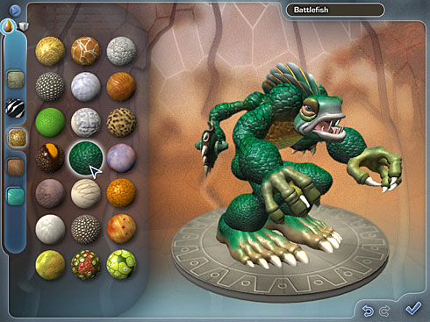
Mainstream AI techniques that have been applied to Games
Genetic Algorithms – encodes characteristics of a system as genes and uses mutation and crossover in conjunction with a fitness function to help evolve to a more “perfect system. Can be used to evolve Artificial-Life creatures to make them “smarter.”
Spore

Slide 7
Genetic Algorithms Example
Imagine you want to build the ultimate fighting creature
And the parameters you can control are
aa=leg length
bb=leg strength
cc=eye sight acuity
dd=arm length
ee=arm strength
ff=aggressiveness
These can be genes/attributes in a chromosome for the creature:
aabbccddeeff e.g. 001011010011

Slide 8
Imagine you create 100 of these creatures with random gene sequences.
Allow them to “fight” in your arena until say 10 are left. I.e. See who is fittest.
Take the 10 and either mutate a few of the genes or crossover genes between 2 creatures in random ways to create another 100 creatures.
E.g. 001011010011 crossed with 101101001001 could produce:
001011 001001
Let them fight again until 10 are left.
Repeat….. for many iterations (i.e. until the same chromosomes seem to keep surviving over and over again).
STOP- you should have evolved the ultimate fighting creature.
http://www.youtube.com/watch?v=ECH1icCL17Y

Slide 9
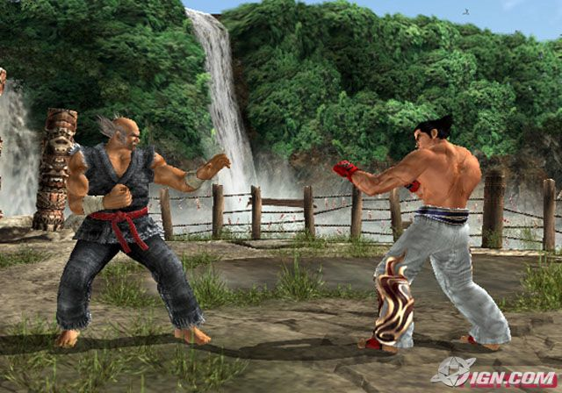
Bayesian Networks
Directed acyclic graphs whose nodes represent variables, and whose arcs encode conditional independencies between the variables. Nodes can represent any kind of variable, be it a measured parameter or a hypothesis.

Slide 10
Bayesian Networks
Example: In a fighting game, predict a player’s third move given his/her first and second move.
Suppose there are three possible moves: Punch, Low Kick and High Kick.
Build a table where the first column represents the first move and the second column represents the third move of the player.
The third column of the table is split into 3 columns, one for each possible move, and each entry represents the count of the third move of the player given the first two moves.
 |  | 3rd move
1st move | 2nd move | Punch | Low Kick | High Kick
Punch | Punch | 10 | 15 | 2
Punch | Low Kick | 1 | 9 | 13
Punch | High Kick | 8 | 0 | 1
Low Kick | Punch | 2 | 3 | 1
Low Kick | Low Kick | 8 | 9 | 15
Low Kick | High Kick | 23 | 1 | 13
High Kick | Punch | 4 | 5 | 9
High Kick | Low Kick | 1 | 2 | 1
High Kick | High Kick | 0 | 8 | 9

Slide 11
Pathfinding
Problem:
NPCs have to figure out how to navigate from point A to point B in a 3D terrain, in real time.
What is the most efficient way?
Watch AI Navigation Bloopers:
http://www.youtube.com/watch?v=lw9G-8gL5o0
Solution:
Dijkstra’s Algorithm- Dijkstra determines shortest path from a vertex to all other vertices in a graph.

Slide 12
E.g. of Dijkstra
Start
Look at neighbors of A and calculate their distances
B/1
A/0
1
4
5
E/∞
2
C/5
D/2
1
1
3
F/∞
Nodes under consideration
Dest

Slide 13
Of the nodes under consideration, look at node with smallest distance and calc distance to neighbors
Start
B/1
A/0
1
4
5
E/5
2
C/5
D/2
1
1
3
Nodes under consideration
F/∞
Dest
Nodes visited

Slide 14
Of the nodes under consideration, look at node with smallest distance and calc distance to neighbors
Start
B/1
A/0
1
4
5
E/5
E/3
2
Save the smaller distance
C/5
D/2
1
1
3
Nodes under consideration
F/5
Dest
Nodes visited

Slide 15
Of the nodes under consideration, look at node with smallest distance and calc distance to neighbors
Start
B/1
A/0
1
4
5
E/3
2
C/5
D/2
1
1
3
Nodes under consideration
F/5
F/4
Dest
Nodes visited

Slide 16
Start
B/1
A/0
1
All this time remember to store the path info in each node as we visited each node
4
5
E/3
2
C has no unvisited neighbors so stop
C/5
D/2
1
1
3
Nodes under consideration
F/4
Dest
Nodes visited

Slide 17
A* Algorithm
A* is an enhancement to Dijkstra where, the node to choose to examine is determined by a heuristic (guess) of how close you are to the destination.
F=G+H [F means Fitness]
G=movement cost to go from current node to your neighbor. [G means Goal]
H=estimated cost to go from the current square to the destination. [H means Heuristic]
E.g. Heuristic in this case is “Manhattan Distance” Distance to walk horizontally & vertically to reach a destination- like when you walk around city blocks (hence the name Manhattan Distance).

Slide 18
Tips on Path Finding
Computing shortest path in real-time is costly.
Instead you can pre-compute all the costs for going from any node to any other node.
Then during runtime, you can just look it up.
You can also create a hierarchy of maps too.
Question: How do you encode “nodes” into a terrain like in a typical first-person-shooter?

Slide 19
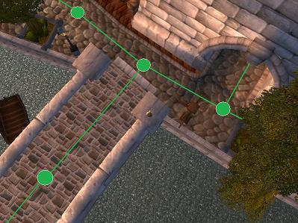
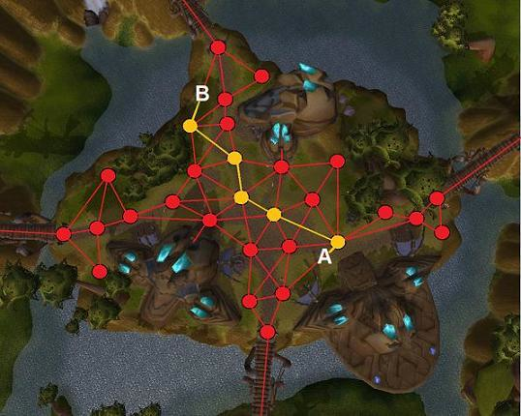
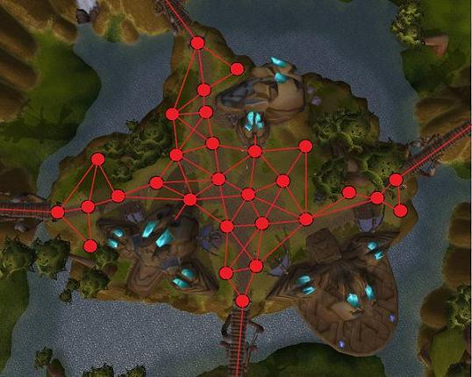
Waypoint Graphs
Most widely used technique currently (even Half Life 2)
Specifies lines where an agent can safely traverse.
http://www.youtube.com/watch?v=WzYEZVI46Uw
Easy to create a graph.
Agent however still needs to do collision detection with the environment to prevent walking into them, or falling off cliffs. Costly for detailed environments.
For larger spaces there may be a need for many nodes otherwise AI may take roundabout paths to get to a destination.
Use of smoothing (like spline) can cause AI to walk through walls.
Nodes can be used to represent nodes for pathfinding in A* rather than creating a massive grid.

Slide 20
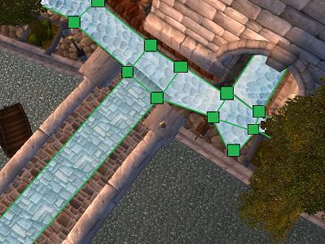
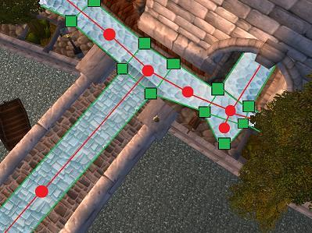
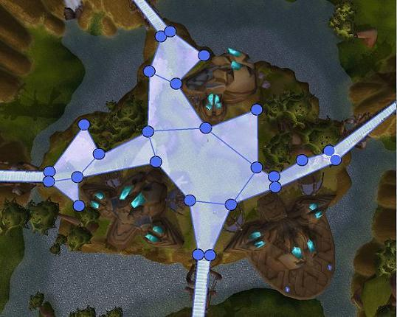
Navigation Meshes
Becoming increasingly popular.
Used in Halo 2,3, Metroid Prime, F.E.A.R.
Convex polygons are used to represent walkable areas rather than waypoints.
An edge is either shared by another polygon- which means walkable.
See Team Fortress Nav Mesh:
http://www.youtube.com/watch?v=9qUqX2GXyPY
Or not shared- which means not walkable.
This reduces collision detection to just the navigation mesh rather than the walls of the environment.
Much fewer nodes needed than waypoint graphs.
However more work is needed to construct the mesh.
Nodes can be associated with each convex polygon if A* heuristics are desired.

Slide 21
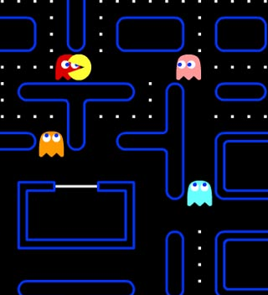
Lower-Tech Approach- Digital Scent
Digital scent that fade away with time.
When user walks about the space, they leave a vector path whose tail segments fades with time.
NPCs can determine if they are close enough to a node of the tail to want to follow it.
Good if the user runs far away and NPC needs a way to find the player without having to go through A*.

Slide 22
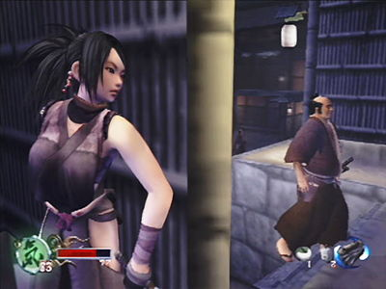
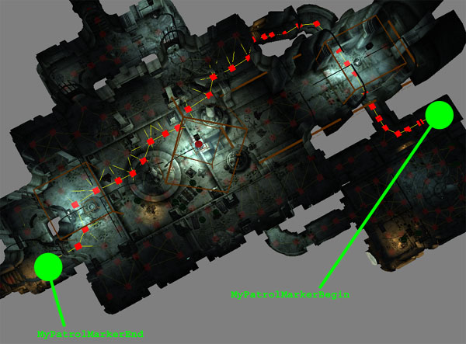
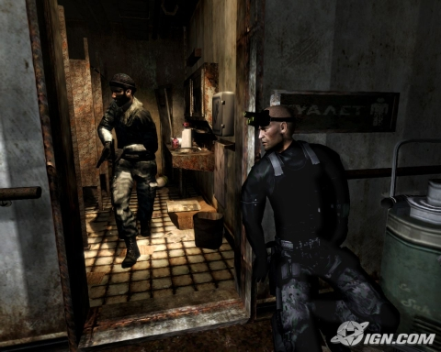
Patroling AI
Pre-defined patrol routes.
When agent is in idle-mode, it can follow a pre-defined patrol path.
Multiple patrol paths can reduce repetitiveness of agent.
Common in stealth games like Tenchu, Splinter Cell.
Can use Waypoint Graphs.

Slide 23
Possible Agent Navigation AI
If idle, perform 1 of N pre-defined patrol routes.
If you are beyond a certain distance from AI turn off AI’s proximity sensors.
With proximity sensors:
If detect you/enemy, jump to “attack” state and move toward you.
If you fire on it, jump to “evade” state. Agent may move at an angle perpendicular to your weapons fire.
If you are beyond a certain range, where navigation may become tricky, follow user’s scent.
If agent loses scent but still wants to pursue, cheat by computing A* path to your location.
Else resume patrol routes- problem is- how do you get back to the old patrol routes??? Agent can keep its own scent so it can follow it back to previous patrol route.
Navigation mesh ensures Ais only walk on safe areas and not fall off a cliff.
Note: Load balancing on agents may be needed to keep compute load down. Give less processing to far away agents.
Play games in cheat mode to observe how agents behave in a “real” game.

Slide 24
Teaching the Computer to Aim
Dead reckoning – predicting the position of an entity (often the game player) at a given moment in time based on the entity’s current position, velocity and acceleration.
By dead reckoning, AI can determine where to shoot to increase its odds of a hit.
Extremely important in First Person Shooters, 3D dog fight games.
But remember to also randomize the aim slightly so that the computer doesn’t look like it’s a perfect marksman.

Slide 25
Calculating Dead Reckoning
2 equations of motion you should know from physics:
v=u+at (1)
s=ut+(at²)/2 (2)
2 methods for calculating dead reckoning
The precise method
The approximate method

Slide 26
Precise Method (Assume a 2D case)
Upm
(Six,Siy)
(Spx,Spy)
Given:
Upm – speed of player
Spx,Spy – position of player
Vbm – speed of AI’s bullet
Sbx,Sby – position of AI’s bullet
Find:
The intersection (Six,Siy)
And from that determine the vector Vb
to fire the bullet.
Vbm
(Sbx,Sby)
Note: User and bullet may also have an acceleration- but for simplicity we will assume the acceleration is zero.

Slide 27
Note that Ubm (ie speed of the bullet) is a magnitude.
The velocity of the bullet has both an x and y component. This is what determines the direction to fire the bullet.
Ie. Ubm = sqrt(Ubx²+Uby²)
Basically you solve for t (the time of the intersection) at (Six,Siy).
In practice this is not really used or necessary because players tend to be erratic. Instead and approximation is used.

Slide 28
Approximate Method
Given:
Upm – speed of player
Spx,Spy – position of player
Ubm – speed of AI’s bullet
Sbx,Sby – position of AI’s bullet
Calculate distance between player and AI’s bullet.
Use s=ut+(at²)/2 to solve for time (t) it would take for the bullet to travel to the player given the speed of the bullet (ie Upm).
Use Upx, Upy, Spx, Spy, t, and same equation to calculate where the player might be in time t
Fire the bullet at that location.
3
Upm
(Spx,Spy)
1,2
4
Ubm
(Sbx,Sby)

Slide 29
Normally you need the enemy to turn to face the player before it is allowed to shoot.
Use 2D Hemiplane Test to test which side Player is on
Given the parametric equations for a line:
P.x= position of E.x + cos(E.yaw) * t
P.z= position of E.z + sin(E.yaw) * t
Solving for t in both cases:
t1= (P.x - position of E.x) / cos(E.yaw)
t2= (P.z - position of E.z) / sin(E.yaw)
If t1=t2 then player is dead-ahead of enemy
If t1 > t2 then player is on one side of the line
If t1 < t2 then player is on the other side
Possible positions (X,Z)
Of the Player (P)
t1<t2
t1=t2
yaw
t1>t2
Position of
Enemy (E)
Now that you know which direction to turn, then you just turn an incremental amount until you reach the goal.

Slide 30
But if you really want the exact ANGLE you can calculate it as follows
Vector P
E.P = ||E|| ||P|| cos Θ
=> Θ = acos(E.P / ||E|| ||P||)
Θ
Vector E
Note, this does not tell you if an enemy is on your left or on your right.
Use previous slide to determine that.
Luckily: In Blitz3D, DeltaYaw#() gives you a +ve and –ve angle
Dot product Magnitude

Slide 31
References
A* Pathfinding for Beginners - Patrick Lester http://www.policyalmanac.org/games/aStarTutorial.htm
AI Game Programming Wisdom – Steve Rabin, Charles River Media.
http://www.aiguru.com/pathfinding.htm
http://www.gameai.com/pathfinding.html
http://www.gamedev.net/reference/list.asp?categoryid=18#94
http://www.netcomuk.co.uk/~jenolive/vect14.html
http://www.ai-blog.net/archives/000152.html

Slide 32
Slide Morgue

Slide 33
Select the node (S) with the smallest F from the TODO List (ie select the node likely to be closest to the goal).
Now remove S from the TODO list and add it to the DONE list.
Check all of the squares x_{i} that are adjacent to S. Ignoring those on the DONE list or unwalkable (terrain with walls, water, or other illegal terrain), add squares to the TODO list if they are not on the TODO list already. Make the S the “parent” of the new squares.
If an adjacent square x_{i} is already on the TODO list, check to see if this path (from S to x_{i}) is a better one. Ie. check to see if G for x_{i} is lower if we use the current square (S) to get there. If not, don’t do anything.
Else if the G cost of the new path is lower, change the parent of x_{i} to point to S. Finally, recalculate both the F and G scores of x_{i}.

Slide 34
Take: s2=s1+v1t+(at²)/2
Eliminate the acceleration in our simplification: s2=s1+v1t
Compute the intersection (Six,Siy) by equating S2 for the bullet & the user
But remember: Vbm = sqrt(Vbx²+Vby²)
So: Vbx = sqrt(Vbm²-Vby²)
Plug in here

Slide 35
So we get this…

Slide 36
But…
Solve for Vby
Plug in here
Then after some algebra…

Slide 37
You get this…
Now just solve this for t
(see website for solution)
Once you have t you can compute Vby with:
And likewise Vbx. With Vbx,Vby you know the direction to fire in.

Slide 38
Fuzzy Logic – use real numbers to determine if a situation belongs to 1 set or another. Kind of like if-statements with probabilities attached to them. Used in The Sims to determine what the action of an agent might be, or could be used in RPGs to determine if something should attack or run away.

Slide 39
E.g. Given a terrain map as follows:
Starting Point
A
Wall
Destination B
Nodes

Slide 40
A Well Known Algorithm in AI called A*
Main idea: Search for the shortest path, starting at point A and checking the adjacent squares, and generally searching outward until we find our target.
Add A to the “TODO list”. The TODO List is a list of squares that need to be checked out.
Look at all the reachable or walkable squares adjacent to the starting point, ignoring squares with walls, water, or other illegal terrain. Add them to the TODO list, too. For each of these squares, indicate A as its “parent square”.
Remove the starting square A from your TODO list, and add it to a “DONE list” of squares. DONE List is a list of squares you’ve already explored.
A

Slide 41
Now choose one of the TODO list items to explore next- but which one?
Path Scoring:
Compute the “cost” of traveling to each of the squares adjacent to A.
F=G+H [F means Fitness]
G=movement cost to go from A to the current square. [G means Goal]
H=estimated cost to go from the current square to the destination (B). [H means Heuristic]
E.g. Heuristic in this case is “Manhattan Distance” Distance to walk horizontally & vertically to reach a destination- like when you walk around city blocks (hence the name Manhattan Distance).

Slide 42
Calculate F,G,H at each of the TODO List items
Assume in this e.g.
Cost to move horizontally/vertically = 10
Cost to move diagonally = 14
F
G
H
A
B

Slide 43
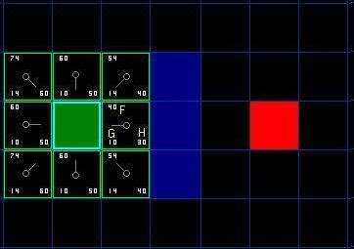
Select the node (S) with the smallest/best F from the TODO List (ie select the node likely to be closest to the goal).
This square has lowest F=40. Call this the selected square S
A

Slide 44
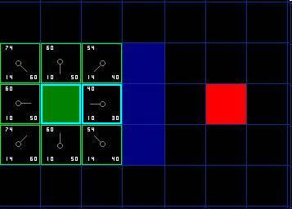
Select S, Remove it from TODO List, Add it to DONE List
S
A
DONE list items

Slide 45
Check adjacent squares from S, and add to TODO List unless they are already on the list.
Adjacent squares x_{i} are already on the TODO list so do nothing
Ignore Non-walkable squares (Wall)
A
S
Adjacent squares x_{i} are already on the TODO list so do nothing

Slide 46
So look at each of the Xi that are already on the TODO list…
A
S
Calculate G to reach here, for e.g., after passed through S
(G=10+10=20)

Slide 47
…and see if this path (A→S→Xi) is better than the previous ones (A→Xi).
G for path A to S to here (G=10+10=20)
S
Compare against
previous path that was already on the TODO list: (G=14)
A
Answer for this case is:
A→S→Xi is more costly than A→Xi, so ignore the path A→S→Xi but keep A→Xi on the TODO list so that you can continue searching from there later.

Slide 48
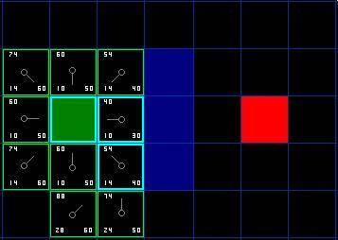
Now repeat the algorithm: Select node (S) with the smallest F in the TODO List, add to DONE List, and examine its adjacent squares (Xi). Add new Xi if not on TODO list.
Ignore walls &
DONE list items
Pick an S
Xi
Lets say we disallow traveling across the corner of a wall
New Xi’s

Slide 49
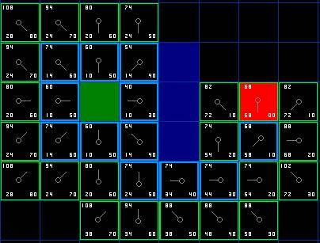
Repeat until Destination B is reached.
TODO
Destination B
DONE

Slide 50
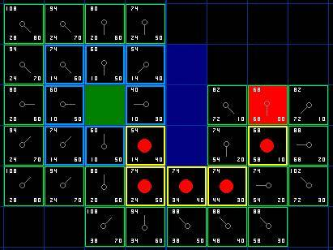
Compute the final path by following the parents from B.

Slide 51
The Whole A* Algorithm Review at your Leisure
Add the starting square to the TODO list.
Repeat the following:
Look for the lowest F cost square on the TODO list. We refer to this as the current square.
Switch it to the DONE list.
For each of the 8 squares adjacent to this current square …
If it is not walkable or if it is on the DONE list, ignore it.Otherwise do the following.
If it isn’t on the TODO list, add it to the TODO list. Make the current square the parent of this square. Record the F, G, and H costs of the square.
If it is on the TODO list already, check to see if this path to that square is better,using G cost as the measure. A lower G cost means that this is a better path. If so, change the parent of the square to the current square, and recalculate the G and F scores of the square. If you are keeping your TODO list sorted by F score,you may need to resort the list to account for the change.
Stop when you:
Add the target square to the TODO list, in which case the path has been found, or
Fail to find the target square, and the TODO list is empty. In this case, there is no path.
Save the path. Working backwards from the target square, go from each square to its parent square until you reach the starting square. That is your path.

Slide 52
A* Mods
Maintaining the TODO List : Best to keep it sorted as new items are added if search space is expected to be large to minimize having to traverse the whole todo list looking for the smallest F. A linked list that you update by inserting and removing from the list is an easy way.
What if there are mobile units that you also have to navigate around? (like other tanks): Use different code to navigate around the mobile unit (like choose any trajectory that is clear) then compute a whole new path to the final destination.
Variable Terrain Costs: G can take into account cost of walking through swamps etc. or through areas where the AI has lost many troops. AI can keep track of an Influence Map that maps out areas where they have lost troops so that they can avoid traversing it by increasing cost in G calculation.
Handling Large Terrains:
Hierarchies of maps – Tiered A* Pathfinding
Pre-computed paths

