Slide 1
CS 426
Game Physics
© Jason Leigh
Electronic Visualization Lab,
University of Illinois at Chicago
2003-2007

Slide 2
Application in Video Games
Racing games: Cars, snowboards, etc..
  Simulates how cars drive, collide, rebound, flip, etc..
Sports games
  Simulates trajectory of soccer, basket balls.
Increasing use in First Person Shooters: UnReal
  Used to simulate bridges falling and breaking apart when blown up.
  Dead bodies as they are dragged by a limb.
Miscellaneous uses:
  Flowing flags / cloth.
Problem is that real time physics is very compute intensive. But it is becoming easier with faster CPUs.

Slide 3
Definitions
Kinematics – the study of movement over time. Not concerned with the cause of the movement.
Dynamics – Study of forces and masses that cause the kinematic quantities to change as time progresses.

Slide 4

Particle Systems
Infinitely small objects that have Mass, Position and Velocity
They are also useful for modeling non-rigid objects such as jelly or cloth (more later).
Motion of a Newtonian particle is governed by:
  F=ma (F=force, m=mass, a=acceleration)
  a=dv/dt (Change of velocity over time- v=velocity; t=time)
  v=dp/dt (Change of distance over time- p=distance or position)
  So a basic data structure for a particle consists of: F, m, v, p.

Slide 5
E.g. a 3D particle might be represented as:
Class particle {
  float mass;
  float position[3]; // [3] for x,y,z components
  float velocity[3];
  float forceAccumulator[3];
}
forceAccumulator is here because the particle may be acted upon by several forces- e.g. a soccerball is affected by the force of gravity and an external force like when someone kicks it. (see later)
Anything that will impart a force on the particle will simply ADD their 3 force components (force in X,Y,Z) to the forceAccumulator.

Slide 6
E.g. 3D Particle System
class particleSystem {
  particle *listOfParticles;
  int numParticles;
  void EulerStep(); // Discussed later
  }

Slide 7
Particle Dynamics Algorithm
For each particle {
  Compute the forces that are acting on the particle.
  Compute the acceleration of each particle:
    Since F=ma; a=F/m
  Compute velocity of each particle due to the acceleration.
  Compute the new position of the particle based on the velocity.
}

Slide 8
How do you calculate velocity?
Recall that:
  a = dv/dt (ie change in velocity over time)
  v = dp/dt (ie change in position over time)
So to find velocity we need to find the integral of acceleration
To find the position we need to find the integral of velocty
A simple numerical integration method (Euler’s Method):
  Q(t+dt) = Q(t) + dt * Q’(t)
  So in our case:
    To find velocity at each simulation timestep:
      v(t+dt) = v(t) + dt * v’(t) = v(t) + dt * a(t) // we know a(t) from F=ma
    To find the position at each simulation timestep:
      p(t+dt) = p(t) + dt * p’(t) = p(t) + dt * v(t) // we know v(t)

Slide 9
E.g. Euler Integration Code (EulerStep)
To find velocity at each simulation timestep:
  v(t+dt) = v(t) + dt * a(t) // we know a(t) from F=ma
  v_next[x] = v_now[x] + dt * a[x];
  v_next[y] = v_now[y] + dt * a[y];
  v_next[z] = v_now[z] + dt * a[z];
To find the position at each simulation timestep:
  p(t+dt) = p(t) + dt * v(t) // we know v(t)
  p_next[x] = p_now[x] + dt * v_now[x];
  p_next[y] = p_now[y] + dt * v_now[y];
  p_next[z] = p_now[z] + dt * v_now[z];
Remember to save away v_next for the next step through the simulation:
  v_now[x] = v_next[x]; v_now[y] = v_next[y]; v_now[z] = v_next[z];

Slide 10
Warning about Euler Method
Big time steps causes big integration errors.
You know this has happened because your particles go out of control and fly off into infinity!
Use small time steps- but note that small time steps chew up a lot of CPU cycles.
You do not necessarily have to DRAW every time step. E.g. compute 10 timesteps and then draw the result.
There are other better solutions:
  Verlet
  Adaptive Step Sizes
  Runge Kutta Method
v
Error
Estimate
t
t₀
t₀+dt

Slide 11
Verlet
Previously:
  v(t+dt) = v(t) + dt * a(t)
  p(t+dt) = p(t) + dt * v(t)
In Verlet integration we choose a velocity-less representation.
I.e. we keep track of the current and previous position only.
  p(t+dt) = 2p(t) - p(t-dt) + a(t) * dt

Slide 12
Advantages / Disadvantages of Verlet
When a point moves past a physical limit then we can simply move the point back to a ”legal" position. There is no need to calculate an impulse velocity, as the velocity is implied in the position, and is automatically handled by the movement.
Quite stable since you don’t have to worry about maintaining a small enough dt for both calculating position and velocity.
Not always very accurate and some energy is dissipated.
Used a lot for molecular dynamics.

Slide 13
Computing Forces
Remember your particles are accelerating due to some Force that acts on it.
Gravity:
  Easy: F = mg where g is the acceleration due to gravity:
    a[x]=0; a[y]=9.8ms⁻²; a[z]=0;
  Use this to compute F and add this to the forceAccumulator parameter.
Viscous Drag:
  Like partcle moving thru water
  F=-k_{d}*V
  K_{d} is coefficient of drag: basically it acts in the opposite direction of the Velocity of your particle.
  Again apply the F by adding it to the forceAccumulator.
Damped Spring:
  See next slide

Slide 14
Spring Systems
(Hooks Law)
Useful for modeling non-rigid objects- like jelly or cloth
P1
P2
Ks (spring constant)
R (resting length)
L = p1-p2
(position of particle 1 – position of particle 2)
Kd (damping constant)
F1 = -[Ks * (|L| - R) + Kd * ((L’ . L)/|L|)] /|L| ; F2 = -F1
L’ is just time derivative of L
ie V1-V2 (difference in velocities of the 2 particles)
Spring force is proportional to the diff between the actual length and rest length
Damping force is proportional to particles 1 & 2’s velocity
Equal and opposite forces act on each of the 2 particles

Slide 15
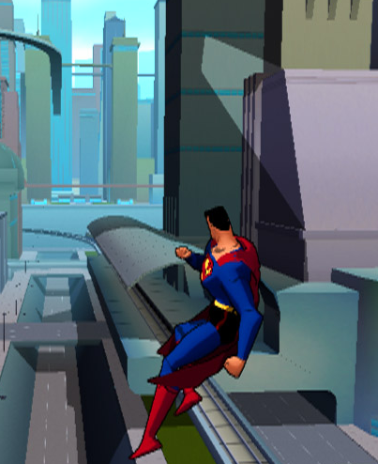
Simulating Cloth

Slide 16
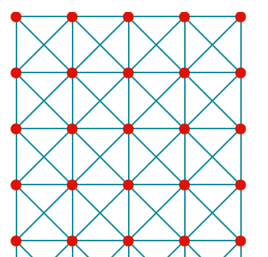
Simulating Cloth
3 kinds of springs needed
Structural Springs
Shear Springs (to prevent the flag from shearing)
E.g.:

Slide 17
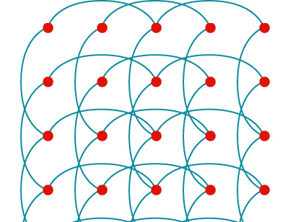
Simulating Cloth
Bend Springs (to prevent the flag from folding along the vertices)
Connect to every other particle.
Cross-section of cloth
Structural springs
Bend springs

Slide 18
Making Blobs
Gish 1 (www.chroniclogic.com/gish.htm)
www.youtube.com/watch?v=5WzGQQOIcp8
Gish 2 Physics (128 particles)
www.youtube.com/watch?v=TTcqZhQnrXw
Bloft Soft Body Physics: bloft.hardwire.cz

Slide 19
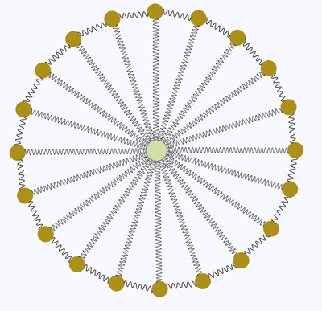
The "skin" of the blob kept folding over themselves, leading to ugly spikes in the skin.
The blob was either too wobbly, meaning the edges of the blob wiggled like a giant piece of Jello, or too stiff, meaning it looked like a rubber ball.
It kept getting caught on things, the outer edges would wrap around a corner of the environment, and the blob would hang there, looking like a dishrag.

Slide 20
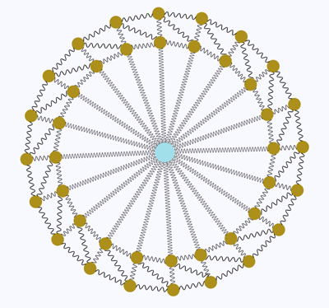
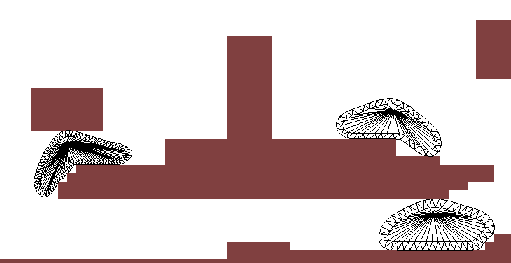
Worked better.
Tweaked “thickness” of outer membrane and spring stiffnesses.
Read this for more details:
cowboyprogramming.com/2007/01/05/blob-physics/
Note: they don’t address how to break apart blobs!

Slide 21
Handling Collisions
Particles often bounce off surfaces.
Need to detect when a collision has occurred.
Need to determine the correct response to the collision.

Slide 22
Detecting Collision
General Collision problem is complex:
  Particle/Plane Collision – we will look at this one coz it’s easy way to start
  Plane/Plane Collision
  Edge/Plane Collision

Slide 23
Particle/Plane Collisions
P=any point on the plane
N=normal pointing on the “legal” side of the plane.
X=position of point we want to examine.
For (X – P) . N
  If > 0 then X is on legal side of plane.
  If = 0 then X is on the plane.
  If < 0 then X is on the wrong side of plane
N
P
X

Slide 24
Collision Response – dealing with the case where particle penetrates a plane (and it shouldn’t have)
If particle X is on the wrong side of the plane, move it to the surface of the plane and then compute its collision response.
X

Slide 25
Collision Response
N=normal to the collision plane
Vn=normal component of a vector V is Vn= (N . V) V
Vt=tangential component is:
Vt=V-Vn
Vb=bounced response:
Vb=(1 – Kf) * Vt – (Kr * Vn)
Kr=coefficient of restitution: ie how bouncy the surface is.
1=perfectly elastic; 0=stick to wall.
Kf=coefficient of friction: ie how much the tangential vector is slowed down after the bounce.
1=particle stops in its tracks. 0=no friction.
N
V
Vb
Vn
Vt

Slide 26
Rigid Body Dynamics
Rigid body dynamics deals with the way rigid bodies (like cars) behave- ie solid objects in general.
This is the key to producing realistic simulations in car driving games where you collide a lot.
Have to deal with angular versions of position, velocity, acceleration and force
Ie: orientation Ω, angular velocity ω, angular acceleration α, torque Τ.
Ω

Slide 27
Rigid Body Dynamics
The gist is:
  Calculate Center of Mass and Moment of Inertia at the Center of Mass
  Moment of inertia is measure of the resistance of a body to angular acceleration: different for different shaped objects. Usually physics engine provide a # of preset shapes.
  Center of Mass is the point where the entire mass of the object appears to reside.
  Set body’s initial position, orientation, linear & angular velocities.
  Figure out all forces acting on the body, including their points of application. (e.g. gravity & collision).
  Sum all the forces and divide by total mass to find CM’s linear acceleration (ie F=ma).
  Compute the total Torque at the CM. Torque is what causes angular acceleration (angular analog of Force).
  Divide Torque by moment of inertia to find angular acceleration.
  Numerically integrate linear and angular acceleration to get linear velocity, position, angular velocity, and orientation.
  You deal with the entire body from its center of mass.
  When rigid bodies collide you need to compute the point of intersection and determine how that collision causes change in angular as well as linear components.
You will need to study the references in depth to figure out how to implement this.
Would make a good Independent Study or MS project- if anyone is interested ☺

Slide 28
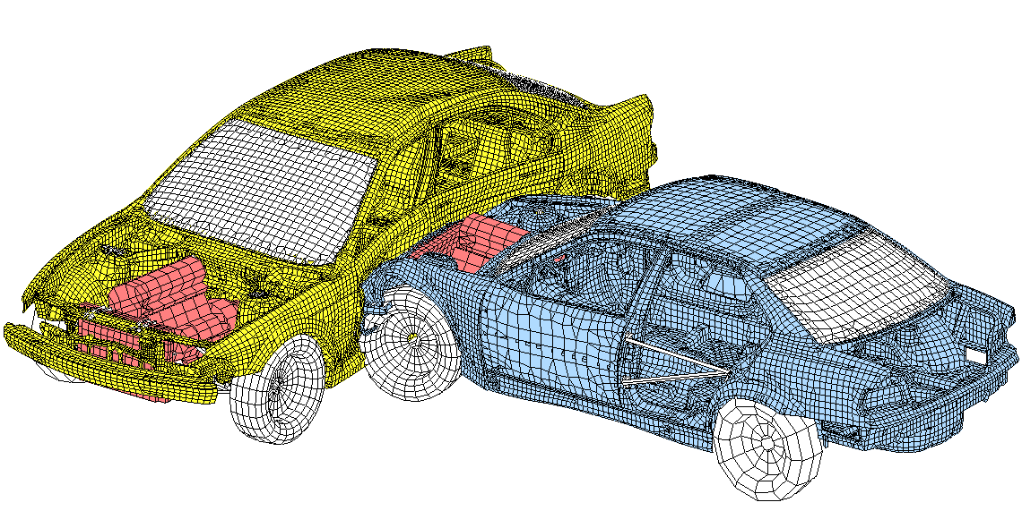
All this wasn’t invented so you could play a better game of Grand Theft Auto…

Slide 29
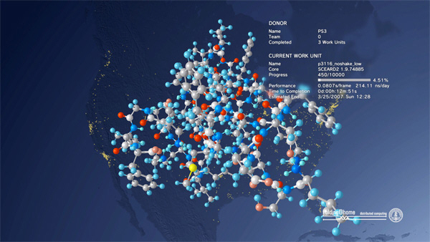
Molecular Dynamics
Folding Proteins

Slide 30
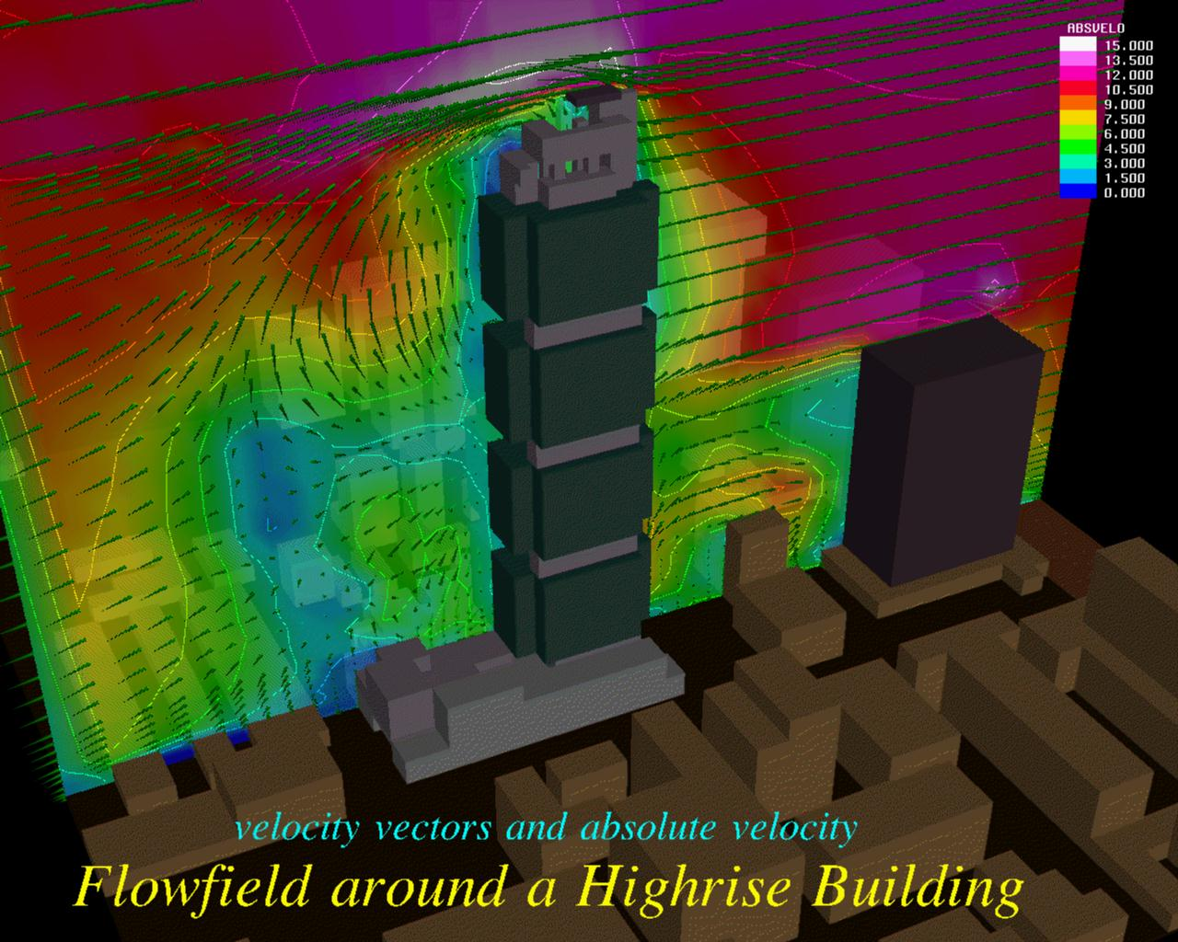
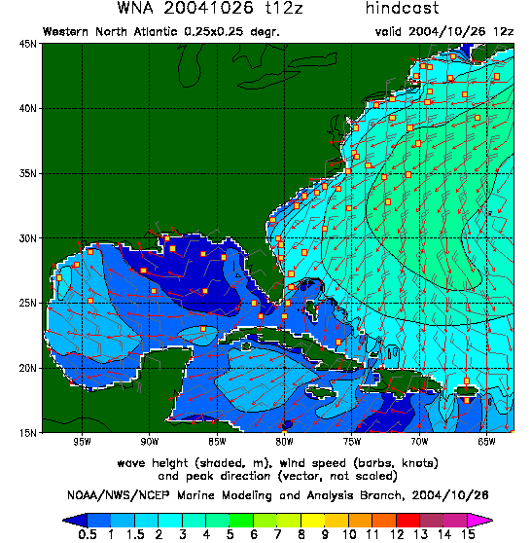
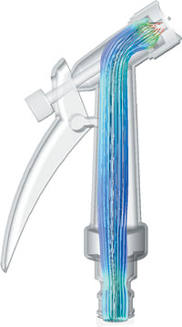
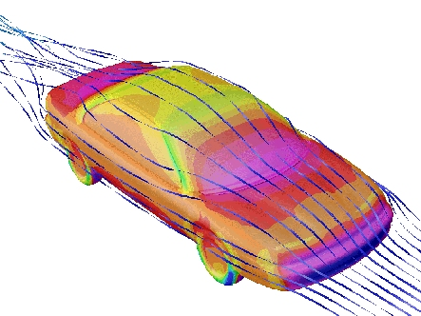
Fluid Dynamics Modeling for Weather Modeling, Airflow Around an Airplane, High Rise, Ship, inside a water hose.

Slide 31
References
“May the FORCE be with you.”
Physics for Game Developers – David M. Bourg: O’Reilly & Associates. [highly recommended]
Open Dynamics Engine: www.ode.org
Tokamak Physics Engine: www.tokamakphysics.com
SIGGRAPH Course Notes 34, 1995– www.siggraph.org
Rigid Body Dynamics: Chris Hecker www.d6.com/users/checker
Jason’s Particle Systems C++ Class: www.evl.uic.edu/cavern/rg/20030201_leigh/
Numerical Solvers:
www.gamasutra.com/features/20000215/lander_01.htm
http://www.evl.uic.edu/cavern/rg/20030201_leigh/diffyq.html

Slide 32
References
http://en.wikipedia.org/wiki/Equations_of_motion
http://www.gamasutra.com/resource_guide/20030121/jacobson_01.shtml
http://cowboyprogramming.com/2007/01/05/blob-physics/
http://www.gamasutra.com/view/feature/1549/practical_fluid_dynamics_part_1.php
Verlet, L. "Computer experiments on classical fluids. I. Thermodynamical properties of Lennard-Jones molecules", Phys. Rev., 159, 98-103 (1967).
Witkin, Andrew and David Baraff, "Physically Based Modeling: Principles and Practice", Siggraph ’97 course notes, 1997.
http://www.cs.cmu.edu/~baraff/sigcourse/index.html

Slide 33
Adaptive Step Sizes
Ideally we want the step-size (dt) to be as big as possible so we can do as few calculations as possible.
But with bigger step sizes you incorporate more errors and your system can eventually destabilize.
So small step sizes are usually needed. Unfortunately smaller step sizes can take a long time.
You don’t want to force a small step size all the time if possible.

Slide 34
Euler with Adaptive Step Sizes
Suppose you compute 2 estimates for the velocity at time t+dt:
So v1 is your velocity estimate for t+dt
And v2 is your velocity estimate if you instead took 2 smaller steps of size dt/2 each.
Both v1 and v2 differ from the true velocity by an order of dt² (because Euler’s method is derived from Taylor’s Theorem truncated after the 2nd term- see reference in the notes section of this slide)
By that definition, v1 and v2 also differ from each other by an order of dt²
So we can write a measure of the current error as: E = |v1-v2|
Let E_{tolerated} be the error that YOU can tolerate in your game.
Adaptive step size dt_{adapt} is calculated as approximately:
dt_{adapt} = Sqrt(E_{tolerated} / E) * dt
So a bigger tolerated error would allow you to take a bigger step size. And a smaller one would force a smaller step size.
Notes:
http://www-2.cs.cmu.edu/afs/cs/user/baraff/www/pbm/diffyq.pdf

Slide 35
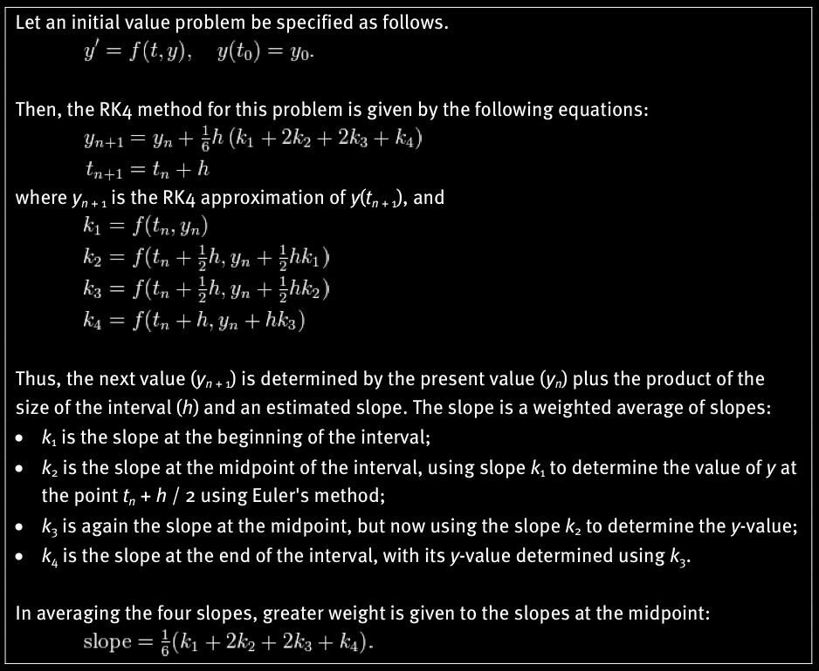
The Common 4th Order
Runge Kutta Method (RK4)

Slide 36
Translating to our problem
Recall: v(t+dt) = v(t) + dt * a(t)
becomes:
v(t+dt) = v(t) + 1/6 dt(k₁+2k₂+2k₃+k₄)
k₁ = a(t,v(t))
k₂ = a(t + ½ dt, v(t) + ½ k₁dt)
k₃ = a(t + ½ dt, v(t) + ½ k₂ dt)
k₄ = a(t + dt, v(t) + k₃ dt)
acceleration is calculated from forces and velocity (e.g. for Force of friction).

Slide 37
Recall: p(t+dt) = pv(t) + dt * v(t)
becomes:
p(t+dt) = p(t) + 1/6 dt(k₁+2k₂+2k₃+k₄)
k₁ = v(t,p(t))
k₂ = v(t + ½ dt, p(t) + ½ k₁dt) → i.e. velocity at t+½ dt
k₃ = v(t + ½ dt, p(t) + ½ k₂ dt)
k₄ = v(t + dt, p(t) + k₃ dt)
So:
k1 = current velocity
k2 = current velocity * ½ dt
k3 = current velocity * ½ dt
k4 = current velocity * dt

